Slide 1

Meet the teacher
September 2026

Slide 2

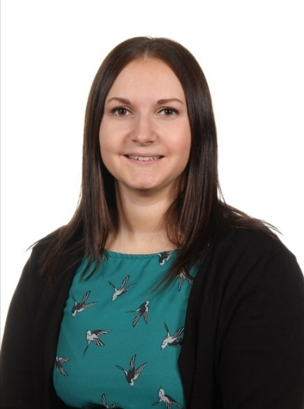
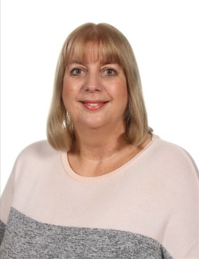
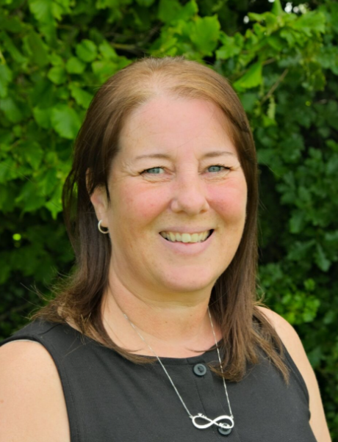
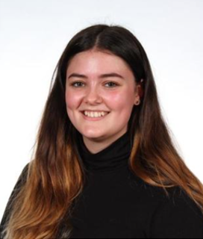
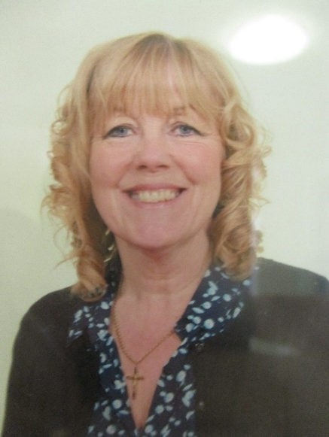
Staffing
Year 3 2026-27
Miss Lucy Racster
Class Teacher
Except Thursdays
Miss Emma Fallon
Learning Support all week
Mrs Dutton-Waugh
Teaching Thursday mornings
Mrs An Joul
Teaching Thursday afternoons
Mrs Karen Cartwright
Teaching Tuesday afternoons

Slide 3
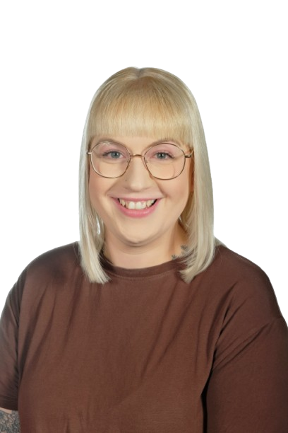
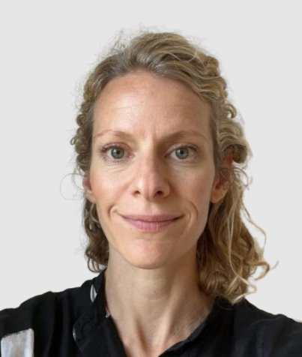
Inclusion Staff
2026-27
Elisabeth Porter
SENDCo
Kirsty Thorpe
Safeguarding and Welfare Officer

Slide 4
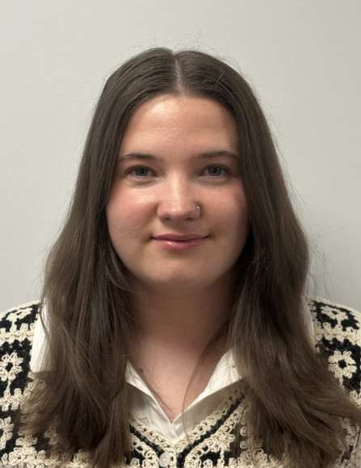
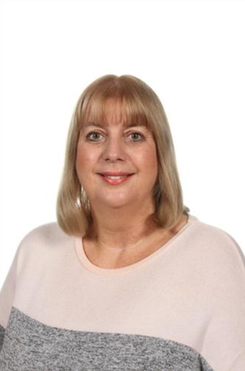
Inclusion Staff
2026-27
Miss Nevill-
Behaviour and Inclusion Officer
Mrs Joul – Learning Mentor

Slide 5

Child Protection Staff

Slide 6
Daily timings
School starts at 08:50 am every day
Classroom doors will be open from 08:45 and pupils are invited to come straight inside
School ends at 03:15 pm every day
Break time for this class is at 10.50
Lunch time for this class is at 12.20 (12 on Tuesdays)

Slide 7
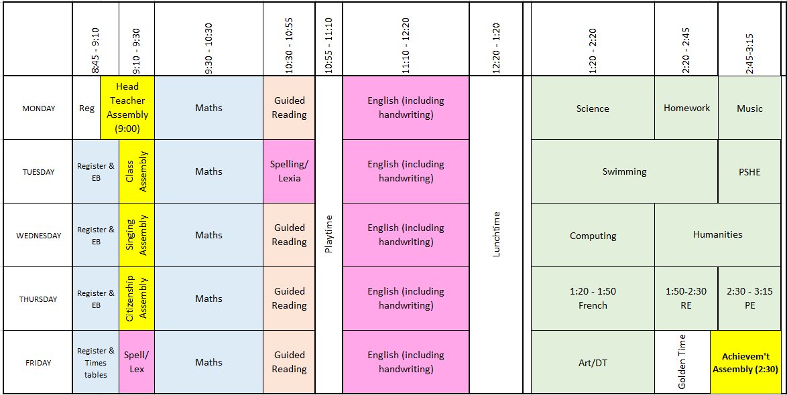
Timetable

Slide 8
Weekly Events
Day | Event
Monday
Tuesday | Swimming (wear kit)
Wednesday
Thursday | PE (wear kit) | Homework due
Friday | Achievement assembly | Homework set
Please note that for PE earrings (studs only) need to be removed once the ears have been pierced for 6 months. If your child cannot do this unaided please send them in without earrings on PE days. Pupils with newly pierced ears will be required to tape up their ears during PE lessons for safety reasons.

Slide 9



Topics this term.
English: This is taught each day. We will be focusing on extending the children’s understanding and application of spelling, grammar and punctuation so they can use this to write for different purposes. There will also be a Guided Reading session 4 times a week.
The text types that we are focusing on this term are:
Setting description – based on ‘Cinnamon’
Non-chronological reports – about Stone Age animals
Diaries – based on ‘Stone Age Boy’
Adverts – about Skara Brae
Although the children have learnt to read or are gaining confidence with their reading, it is still vitally important to talk to them about their reading and share books and stories together. Sustained reading and looking for key information in the text are vital skills for when they progress through school which can be practiced at home by reading for at least 10 minutes each night. If your child is not yet confident in reading, it is vital that they regularly read at home.

Slide 10
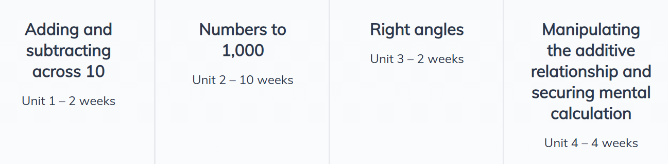
Maths:
This is taught each day.
We use the NCETM scheme with OAK Academy supporting resources to teach Maths.
This half-term we begin with number; specifically numbers to 10,000, place value and addition/subtraction.
Activities in maths lessons will require the children to think, question and apply skills they have. We aim to make them all confident and logical in their approach to work.
You can help by supporting your child to learn and remember addition/subtraction bonds, any times tables they do not know and sharing with them real-life applications of maths, eg. Counting money, weighing out ingredients for recipes, telling the time.

Slide 11
Topics this term.
Science: Rocks, fossils and soil; Light
Geography: Fairtrade
History: Stone Age to Iron Age; Black History
RE: How do Jews use stories to remember God’s Covenant?
PSHE: My Healthy Self; Connecting with Others
Art: Cave painting
DT: Pneumatic Toys
Computing: Online safety; Networks; Programming
Music: Recorders
PE: Swimming and Golf.

Slide 12
Homework
Years 3, 4 and 5
1.5 hours per week which will include Reading, Spelling, other English and Maths work with occasional tasks in other subjects
Reading at home which may include online reading activities
Phonics or extra maths from boosters may be also set for groups or individuals
Pupils who do not complete homework will be given time/help to do this the following playtime.
For Autumn Term, Year 3 will be completing 1 hour of homework per week to ease the transition into KS2. The extra .5 will be introduced in the Spring term.
The websites below will also give you further helpful information:
http://www.nnparenttoolkit.org.uk/information-for-parents/ (Maths)
http://www.theschoolrun.com/ (Maths, Literacy and other primary subjects)
It is REALLY IMPORTANT for children to ensure they are confident with 2,5 and 10 times tables and to start learning other times tables, starting with 4s and 8s. We are still subscribing to TTrock stars and children should access this at least twice a week at home.
They also need to be able to tell the time accurately using digital and analogue clocks, as this is a life skill.

Slide 13

Possible trips and events
Hopefully, we will be able to go on trips and take part in lots of exciting activities this year. These could include:
Stone Age trip to Skelton Grange
City Museum in Summer for Egyptians

Slide 14

School Uniform
School uniform is supplied by Uniwears
info@uniwears.co.uk
More details can be found via the below link:
Uniform Webpage

Slide 15
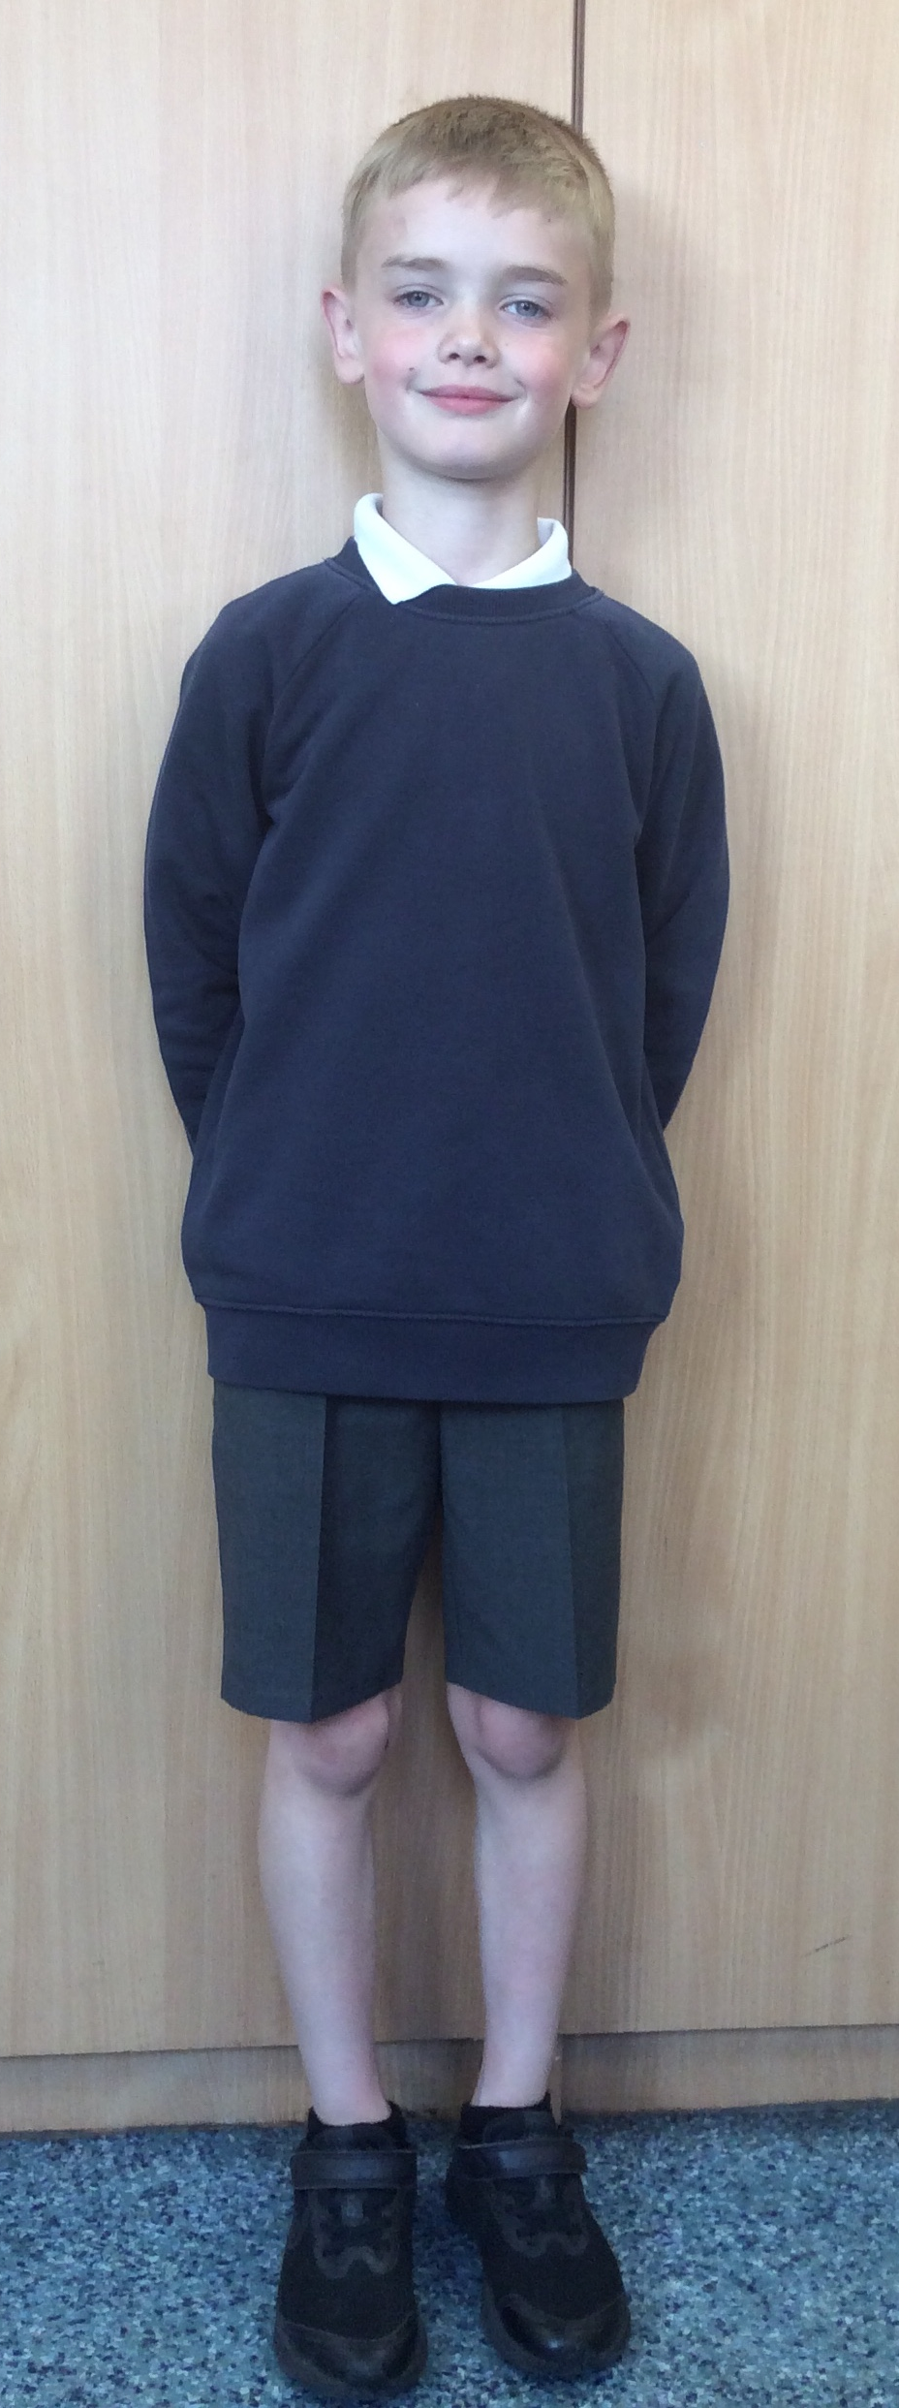
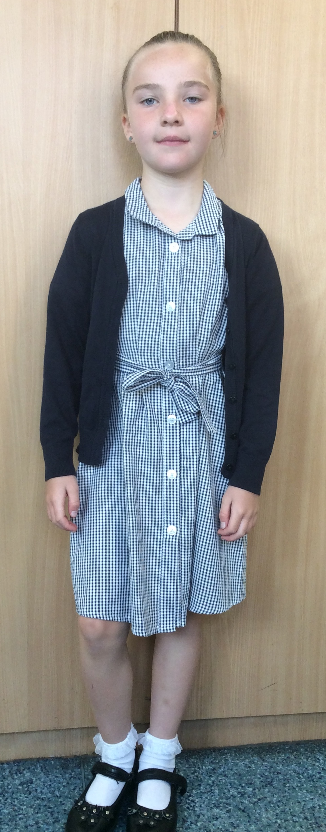
Uniform
Navy school jumper (with or without logo)
Navy school cardigan (with or without logo)
White polo shirt or shirt
Grey school trousers/skirt
Grey school dress
Blue checked school summer dress
Grey school shorts
Black shoes or trainers that children can fasten independently e.g. Velcro
Long hair must be tied up / no extreme hair styles
PE Kit
  Coloured t-shirt (Linked to teams used for PE etc)
  Black or grey PE shorts
    or
  Black or grey jogging bottoms or leggings
  Navy hooded top with logo

Slide 16
Communication
School communicates through email, text messages and sometimes paper letters.
Each Friday, a weekly newsletter comes home with details of all that is going on in school.
Class teachers will also email to share specific information and updates.
School can list 2 numbers as priority one contacts so that both parents receive any general text messages sent.
Please add the following emails to your contacts so that emails come straight to your inbox:
  manston.primary@manston.leeds.sch.uk
  no-reply@mail.arbor-education.com

Slide 17
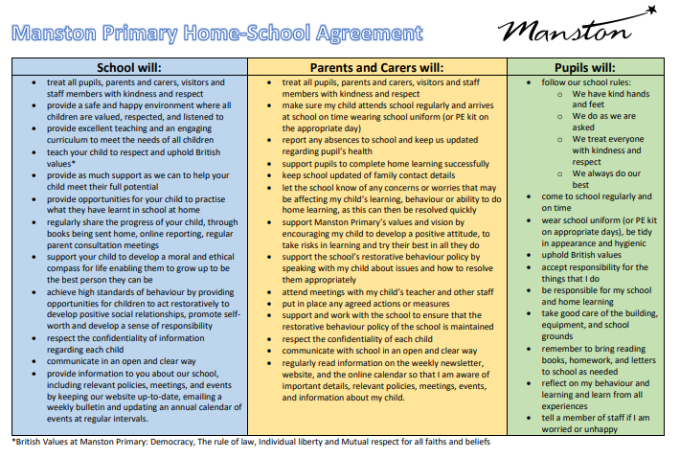
Home School Agreement
An updated copy of this, including an online safety pupil user agreement has come home recently.
Please review this at home with your child.
This agreement applies to all pupils, parents and staff at Manston Primary

Slide 18
Equipment
Each day children will need to bring:
A named water bottle
Named coats, hats, gloves suitable to the weather
Homework when it is finished – it can be brought in earlier than the due date to be kept in class.​
School reading book​
On swimming days: swimwear under their PE kits, a towel, underwear, a spare large bag that will fit in their clothing and coats, goggles if needed.
Pupils do not need:
Pencil cases
Toys or games
School staff cannot spend time looking for items that are not named.

Slide 19
Attendance.
Our pupils have excellent attendance, and this is something we want to keep improving.
If your child is absent, please ring, email or speak with a member of staff in the office to let them know the details of the absence.
Please be reminded that school cannot authorise holidays in term time and any applications for exceptional leave must be made by filling in a form from the office.
School starts at 08:50 am each day and finishes at 3:15pm
Further details including our full policy can be found on our school website.

Slide 20
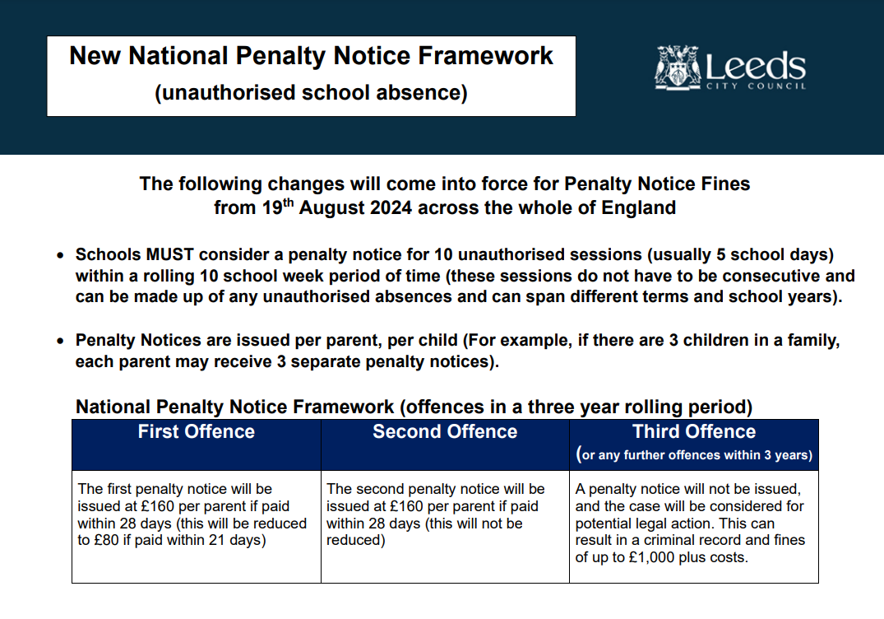

Slide 21
Frequently Asked Questions
What happens on a swimming day?​
The children will go for an early lunch so that they are ready to leave school at 1pm. We will sensibly walk from school to John Smeaton in pairs. The children will then arrive at swimming and quickly get changed for a 30 minute session in the pool. There will be different groups in the pool working with an instructor and/or adult. These will be decided later in the term by the swimming instructors and may also change through the year depending on assessments and progress. After the lesson, the children will get changed and walk back to school. This is done within a time limit as the changing rooms need access and there will be a lesson before home time in school. If your child struggles to independently get changed, practising at home with a timer is a great way to support them. ​
​
What happens if my child does not bring in their homework?​
Homework is part of our school policy and is part of the home school agreement previously mentioned. Getting your child into a routine of doing homework will not only recap previous learning but will also prepare them for when they progress up school and homework is increased. The odd missed homework for important circumstances is understandable however regular missed or late homework will result in your child missing their reward play and you may need to attend a meeting with myself and senior leadership to discuss next steps.​

Slide 22

Data Checking
Please check/update the details we hold for your child to ensure we have:
At least 2 emergency contacts
Current emails/ addresses
Up to date medical information
Any medication / information is up to date
You can do this by emailing the school office or updating details on the Arbor App.

Slide 23
Any Questions?
School Email: manston.primary@manston.leeds.sch.uk
Class teacher email: lucy.racster@manston.leeds.sch.uk
Queries about swimming: karen.cartwright@manston.leeds.sch.uk
Do not hesitate to get in touch if you have any questions or need some support.

