Slide 1

Meet the teacher
September 2026

Slide 2

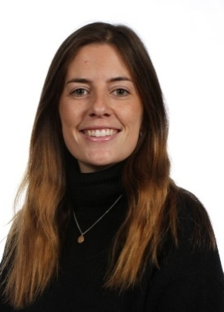
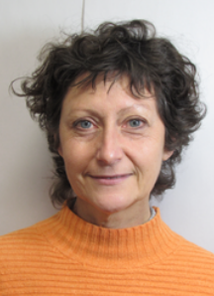
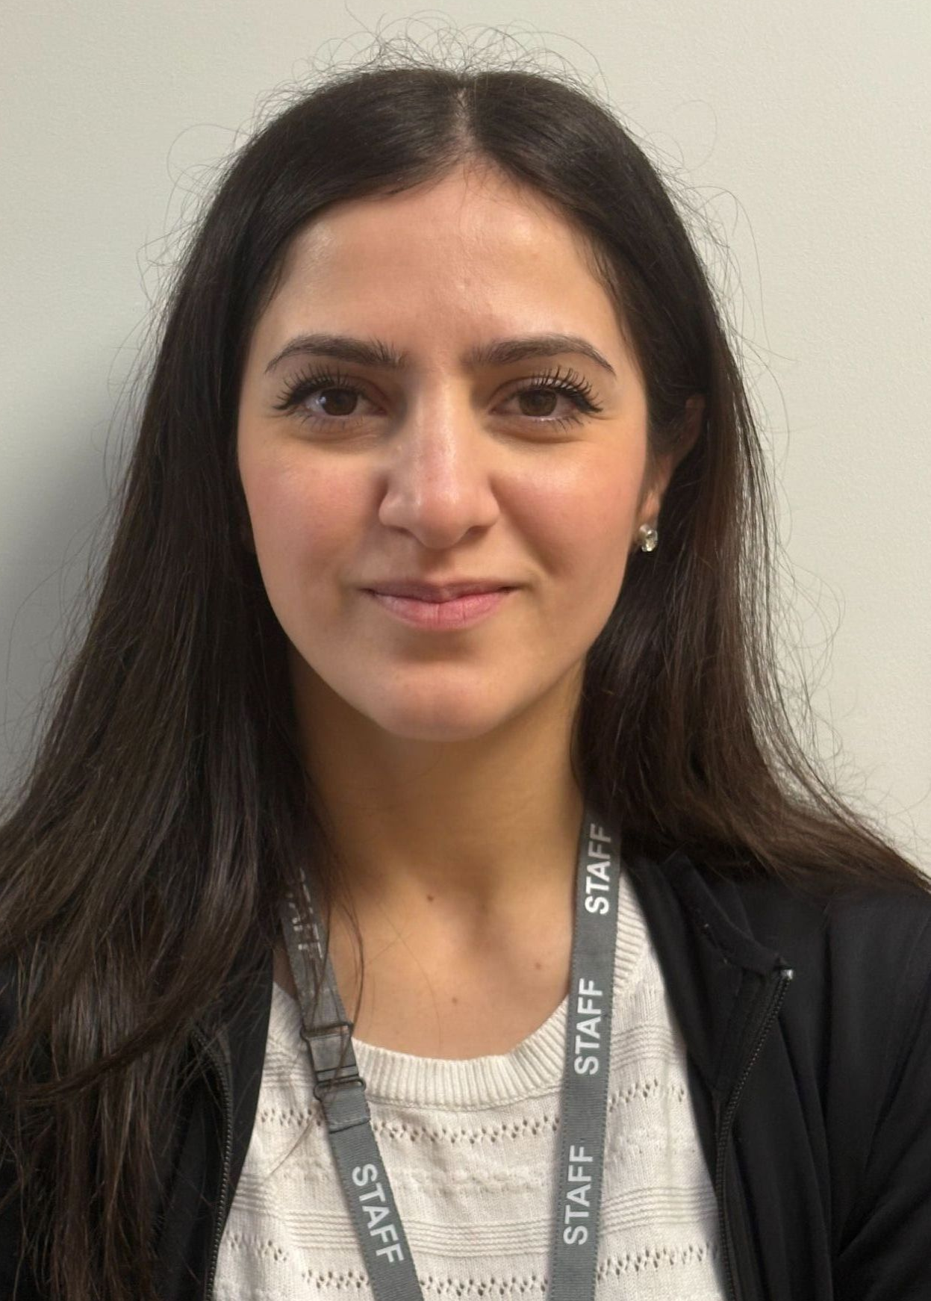
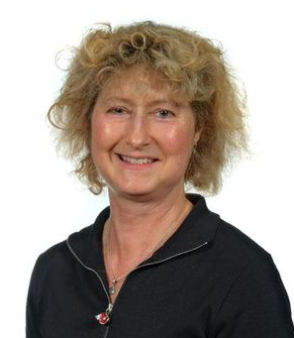
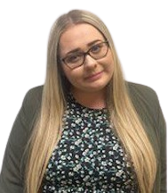
Staffing
Reception
Miss Evans
Class teacher
Monday – Wednesday
Mrs Goddard
Class teacher
Thursday – Friday
Mrs Roberts
Learning Support
Assistant
Miss Khorshed
Learning Support
Assistant
Miss Oddy
Learning Support
Assistant

Slide 3

Child protection Staff

Slide 4
Daily timings
School starts at 8:50am every day
Classroom doors will be open from 8:45am and pupils are invited to come straight inside
School ends at 3:15pm every day
Lunch time for this class is at 11:45am

Slide 5
School Rules
We do as we are asked​
We treat everyone with kindness and respect​
We keep our hands and feet to ourselves​
We always do our best​

Slide 6
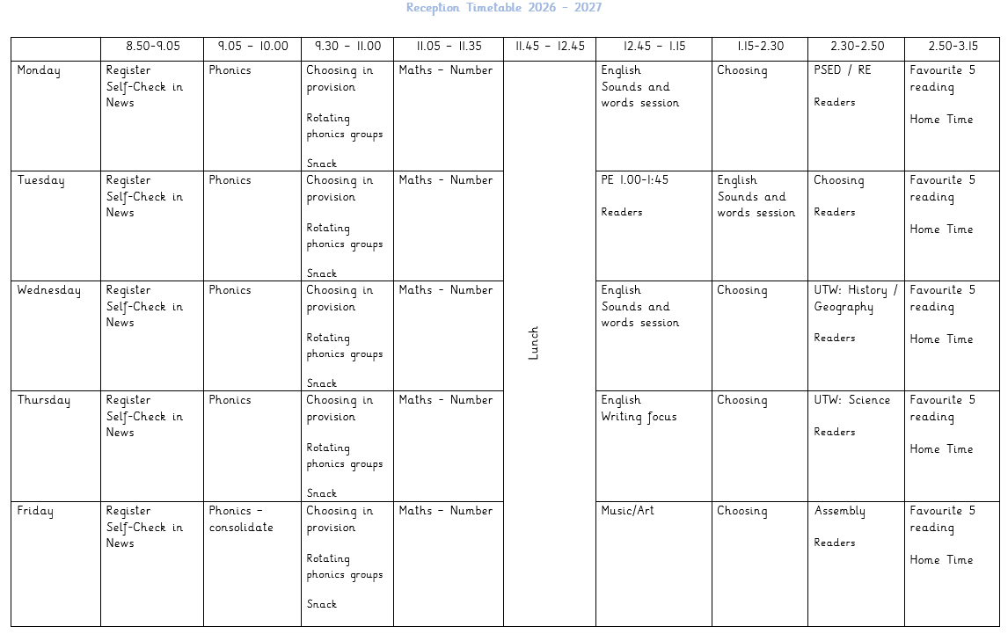
Timetable (subject to small changes)

Slide 7
Weekly Events
Day | Event
Monday
Tuesday | PE (wear kit)
Wednesday
Thursday
Friday
Please note that for PE earrings (studs only) need to be removed once the ears have been pierced for 6 months. If your child cannot do this unaided please send them in without earrings on PE days. Pupils with newly pierced ears will be required to tape up their ears during PE lessons for safety reasons.

Slide 8


Topics this term
English/ Topic:
Feelings, all about me, traditional fairy tales, festivals & celebrations
Maths:
Mastering Number, Numbers 1-10 with Numberblocks/ Patterns/ Shape​
Phonics:
Floppy’s Phonics​

Slide 9
Homework
Reception
Parents and carers are encouraged to share books together with a reading book sent home to be read daily.
Please bring in reading bag/books to school daily.
Two phonics sheets to complete each week.
Maths, English or Topic homework may also be sent home weekly/fortnightly.

Slide 10

Possible trips and events
Some exciting trips or events this year could include:
Baby chicks or frogs in school
Visitors such as the police, firefighters, school cook etc
Local park or library visit
Swithens Farm in Summer term
Celebration afternoon in July

Slide 11
Uniform
Branded school uniform can be purchased from – Uniwears.
https://www.uniwears.co.uk/products/manston-primary-school-sweatshirt?_pos=3&_sid=7b719498d&_ss=r&variant=47855109734745
Non branded dark blue versions of jumpers and cardigans are also fine for children to wear.
Pupils need to wear PE kit on their PE days including those that go swimming

Slide 12
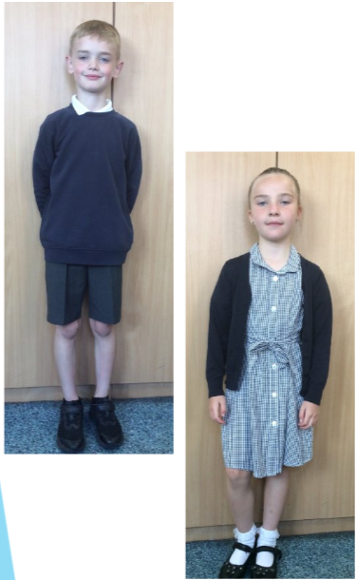

Uniform
Navy school jumper (with or without logo)​
Navy school cardigan (with or without logo)​
White polo shirt or shirt​
Grey school trousers/skirt​
Grey school dress​
Blue checked school summer dress​
Grey school shorts​
Black shoes or trainers that children can fasten independently
e.g. Velcro​
Long hair must be tied up / no extreme hair styles​
PE Kit​
Coloured t-shirt (Linked to teams used for PE)​
Black or grey PE shorts​/jogging bottoms/leggings​
Navy hooded top with logo​

Slide 13
Communication
School communicates through email, text messages and sometimes paper letters.
Each Friday, a weekly newsletter is emailed out with details of all that is going on in school.
Class teachers will also email to share specific information and updates.
School can list 2 numbers as priority one contacts so that both parents receive any general text messages sent.
Please add the following emails to your contacts so that emails come straight to your inbox:
  manston.primary@manston.leeds.sch.uk
  no-reply@mail.arbor-education.com
  olivia.evans@manston.leeds.sch.uk
  kay.goddard@manston.leeds.sch.uk

Slide 14

Home School Agreement
Please review this at home with your child.
This agreement applies to all pupils, parents and staff at Manston Primary

Slide 15
Equipment
Each day children will need to bring:
A named water bottle
Named coats, hats, gloves suitable to the weather
Any completed homework
Reading book and reading record
Pupils do not need:
Pencil cases
Toys or games
Please ensure all uniform and other items of clothes/belongings are named. School staff cannot spend time looking for items that are not named.

Slide 16
Attendance.
Our pupils have excellent attendance, and this is something we want to keep improving.
If your child is absent, please ring, email or speak with a member of staff in the office to let them know the details of the absence.
Please be reminded that school cannot authorise holidays in term time and any applications for exceptional leave must be made by filling in a form from the office.
School starts at 08:50 am each day and finishes at 3:15pm
Further details including our full policy can be found on our school website.
Please note that new legislation about term time holidays came into force in August 2024.

Slide 17
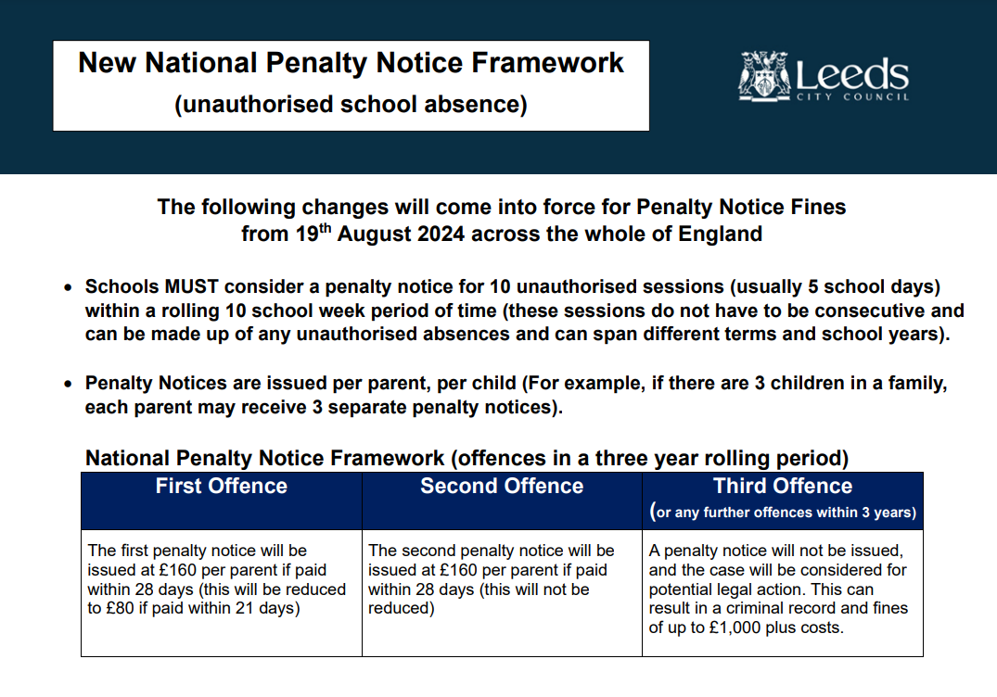

Slide 18

Data Checking
Please check/update the details we hold for your child to ensure we have:
At least 2 emergency contacts
Current emails/ addresses
Up to date medical information
You can do this by emailing the school office or updating details on the Arbor App.

Slide 19
Any Questions?
School Email: manston.primary@manston.leeds.sch.uk
Class teacher emails: olivia.evans@manston.leeds.sch.uk
kay.goddard@manston.leeds.sch.uk
Olivia Evans is class teacher Monday – Wednesday,
Kay Goddard is class teacher on Thursday and Fridays.
Do not hesitate to get in touch if you have any questions or need some support.

