Slide 1
Meet the teacher
September 2024

Slide 2
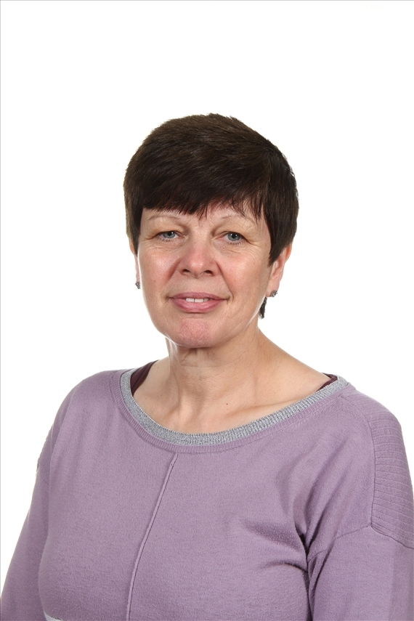
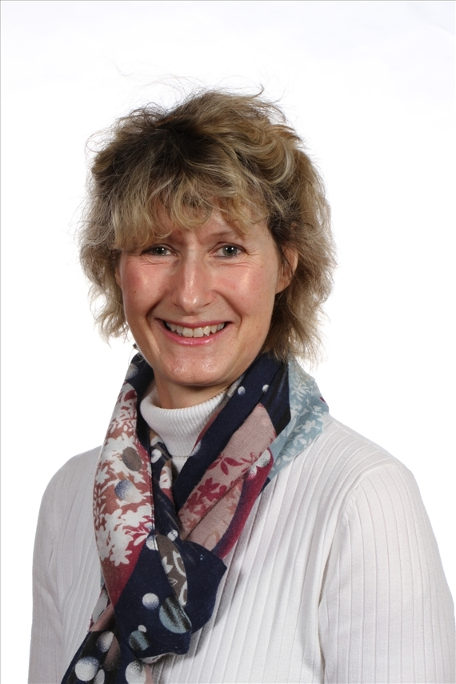
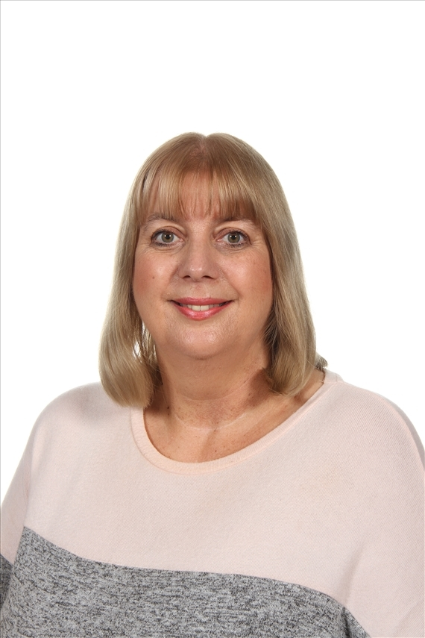
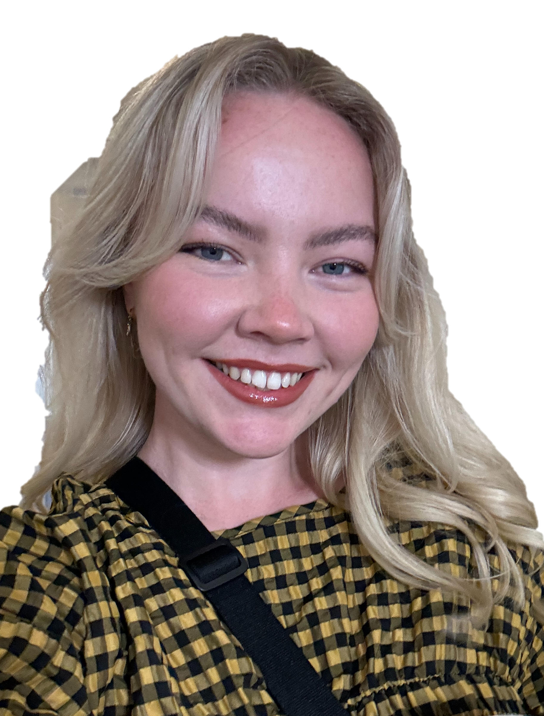
Staffing
Year 5 2024-25
Miss Olivia Galbraith – Class Teacher
Mrs Joul
HLTA – Wednesday afternoon
Mrs Julie Lamb - LSA
Mrs Jane Wiles - LSA
Miss Oddy –
Wednesday

Slide 3
Child protection Staff

Slide 4
Daily timings
School starts at 08:50 am every day
Classroom doors will be open from 08:45 and pupils are invited to come straight inside
School ends at 03:15 pm every day
Break time for this class is at 10.40
Lunch time for this class is at 12.20

Slide 5
Timetable
Day | Sessions | Break | Sessions | Lunch | Lesson 3 | Lesson 4
Monday | Assembly Maths Spelling |  | English Guided reading |  | Science | PSHE
Tuesday | Assembly Maths Spelling |  | English Guided Reading |  | Geography | Music
Wednesday | Singing assembly/Maths |  | English Guided Reading |  | RE French | PE
Thursday | Maths Spelling |  | English Guided Reading |  | Art | ICT
Friday | Maths |  | English Guided Reading |  | PE | Reward Time Achievement Assembly

Slide 6
Weekly Events
Day | Event
Monday |  | Homework set
Tuesday |  | Homework due Homework set
Wednesday | PE (wear kit)
Thursday |  | Homework due
Friday | PE (wear kit) | Achievement assembly
Please note that for PE earrings (studs only) need to be removed once the ears have been pierced for 6 months. If your child cannot do this unaided, please send them in without earrings on PE days. Pupils with newly pierced ears will be required to tape up their ears during PE lessons for safety reasons.
This is a guide for homework – this might change but generally there will be some TTRS, English (SPaG/Reading) and occasionally other subjects.

Slide 7
Topics this term.
English: This is taught each day. Over the year there will be continued focus on grammar, writing skills, spelling and extended writing. We will do guided reading each day. The text types that we are focusing on this term are: poetry, non-chronological reports, recounts and mystery stories. We are expecting that most of the children reach age related expectations in English skills, and we will be supporting and giving work to help with this. Although the children are older and have learnt to read, it is still vitally important to talk to them about their reading and share books and stories together. This helps them develop their skills and a love of reading.
You can also support by revising weekly spellings with children – these will be taught in class but every bit of practice helps!
Maths: This is taught each day. This half-term we begin with number; specifically, place value, addition/ subtraction, multiplication and division skills. We will also have an investigations and problem solving which require the children to think, question, reason and apply skills they have learnt. We aim to make them all confident and logical in their approach to work.
You can help at home by supporting children to remember addition/subtraction number bonds, practising any times tables they may need to work on and sharing with them real-life applications of maths e.g gas/electricity meters, phone bills, weighing ingredients for recipes etc.
Ensuring children are confident in time telling using both analogue and digital clocks is vital too!

Slide 8
Topics this term.
Science: Forces & Earth and Space Geography: Greece – Would you rather live in Greece or Britain?
History: Ancient Greece – What have we learnt from the Ancient Greeks? RE: Special Places and Journeys PSHE: Keeping Safe and Managing Risk & Mental Health and Emotional Wellbeing Art: Painting and Mixed Media: Portraits & Drawing (Artist Focus: Banksy) and Graffiti Art Computing: Computing systems and networks: Search engines
Online safety & Programming 1: Music and Data handling – database Music: following Charanga on-line music resource planning.
Living on a Prayer and Body Percussion/Christmas Concert
PE: Danish Longball/Rounders & Outdoor adventurous activities, which will include orienteering and Real PE which gives lots of opportunities to practise and enhance skills. Gymnastics and Dance
PE will be on Wednesday pm and Friday pm.

Slide 9
Homework
Reception
Parents and carers are encouraged to share books together with a reading book sent home to be read daily.
Maths work may also be sent home once a week.
Home phonics packs for daily practice
Years 1 and 2
1 hour per week which will include Reading, Spelling/ Phonics, other English and Maths work / topic work
Reading at home 4 or 5 times a week for 10/15 minutes
Years 3, 4 and 5
1.5 hours per week which will include Reading, Spelling, other English and Maths work with occasional tasks in other subjects
Reading at home which may include online reading activities
Phonics or extra maths from boosters may be also set for groups or individuals
Pupils who do not complete homework will be given time/help to do this the following playtime.
Year 6
30 minutes four times a week, Regular weekly schedule with continued emphasis on English and maths, but also ranging widely over the curriculum. Set Monday to Thursday and due in the following day.
Pupils who do not complete homework will be given time/help to do this the following playtime.
The websites below will also give you further helpful information:
http://www.nnparenttoolkit.org.uk/information-for-parents/ (Maths)
http://www.theschoolrun.com/ (Maths, Literacy and other primary subjects)
It is REALLY IMPORTANT for children to learn any times tables they still aren’t confident about- we are still subscribing to TT Rock stars and children should access this at least twice a week at home. They also need to be able to tell the time accurately using digital and analogue clocks, as this is a life skill.

Slide 10
Possible trips and events
Hopefully, we will be able to go on trips and take part in lots of exciting activities this year. These could include:
Ancient Greek Day – December – date TBC
Residential Trip to Bewerley Park – March 19th – 21st
WW1 Trip – Spring
Historical Association visit in school
Whitby - July

Slide 11
Uniform
Branded school uniform can be purchased from – Uniwears.
https://www.uniwears.co.uk/products/manston-primary-school-sweatshirt?_pos=3&_sid=7b719498d&_ss=r&variant=47855109734745
Non branded dark blue versions of jumpers and cardigans are also fine for children to wear.
Pupils need to wear PE kit on their PE days including those that go swimming

Slide 12
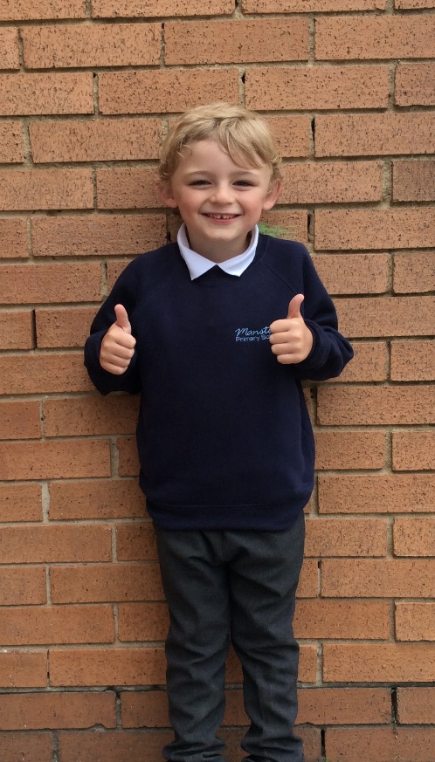
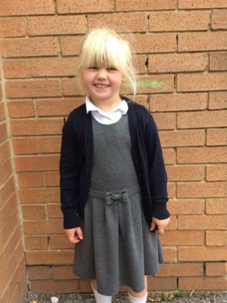
Uniform
Navy school jumper (with or without logo)
Navy school cardigan (with or without logo)
White polo shirt or shirt
Grey school trousers/skirt
Grey school dress
Blue checked school summer dress
Grey school shorts
Black shoes or trainers that children can fasten independently e.g. Velcro
Long hair must be tied up / no extreme hair styles
PE Kit (worn on PE days)
Team coloured t-shirt
Black or grey PE shorts
or
Black or grey jogging bottoms or leggings
Navy hooded top with logo

Slide 13
Communication
School communicates through email, text messages and sometimes paper letters.
Each Friday, a weekly newsletter comes home with details of all that is going on in school.
Class teachers will also email to share specific information and updates.
School can list 2 numbers as priority one contacts so that both parents receive any general text messages sent.
Please add the following emails to your contacts so that emails come straight to your inbox:
manston.primary@manston.leeds.sch.uk
no-reply@mail.arbor-education.com

Slide 14
Home School Agreement
An updated copy of this, including an online safety pupil user agreement has come home recently.
Please review this at home with your child.
This agreement applies to all pupils, parents and staff at Manston Primary

Slide 15
Equipment
Each day children will need to bring:
A named water bottle
Named coats, hats, gloves suitable to the weather
Homework
Reading book
Pupils do not need:
Pencil cases
Toys or games
Names are super important to make it easier if things do get misplaced!
Pupils only need to bring a phone if they walk to/from school alone. This will be kept locked away during the school day and returned to children at home time.

Slide 16
Attendance.
Our pupils have excellent attendance, and this is something we want to keep improving.
If your child is absent, please ring, email or speak with a member of staff in the office to let them know the details of the absence.
Please be reminded that school cannot authorise holidays in term time and any applications for exceptional leave must be made by filling in a form from the office.
School starts at 08:50 am each day and finishes at 3:15pm
Further details including our full policy can be found on our school website.
Please note that new legislation about term time holidays came into force in August 2024.

Slide 18
Frequently Asked Questions
What can I do to help my child at home?
Reading for at least 10 minutes every day can have a massive impact on learning, practise times tables, learn time telling, practise dealing with money, encourage regular completion of homework.
How do I give permission for my child to walk home alone?
Please email olivia.Galbraith@manston.leeds.sch.uk
Can my child bring a phone to school?
Again, children are only able to bring a phone if they will be walking to/from school alone. We will keep these safe during the school day.
When do you do relationships and sex education?
This is done in the spring term, starting in January. An email will be sent to all parents first with the details of what will be taught. We feel it is really important that children are given clear teaching of this topic rather than hearing it inaccurately from their peers.

Slide 19
Data Checking
Please check/update the details we hold for your child to ensure we have:
At least 2 emergency contacts
Current emails/ addresses
Up to date medical information
You can do this by emailing the school office or updating details on the Arbor App.

Slide 20
Any Questions?
School Email: manston.primary@manston.leeds.sch.uk
Class teacher email: olivia.galbraith@manston.leeds.sch.uk
Do not hesitate to get in touch if you have any questions or need some support.

