Slide 1
Meet the teacher
September 2024
Year 6 - Mr. Spinks

Slide 2
Child protection Staff

Slide 3
Daily timings
School starts at 8:50 am every day.
Classroom doors will be open from 8:45 and pupils are invited to come straight inside.
School ends at 3:15 pm every day
Break time for this class is at 10:40
Lunch time for this class is at 12:20

Slide 4
Break Times and Lunch Times
Most pupils will eat their lunch in the hall.
Year 6 & 5 Pupils eating a packed lunch will do this in the Year 6 classroom.
Lunch times are staggered so that our younger pupils eat first and then go out to play while our older pupils eat.
Break times are also staggered, pupils in Years 1-3 and 4-6 will be having playtime at the same time each day.

Slide 5
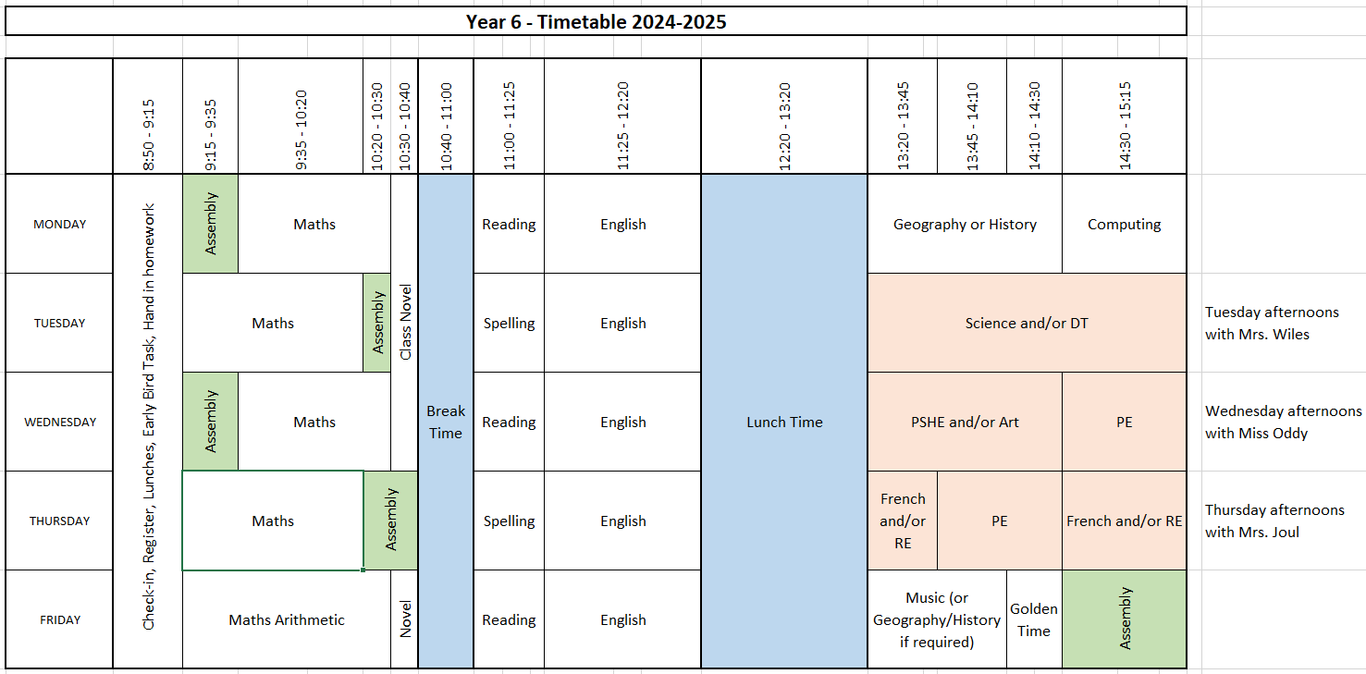
Timetable

Slide 6
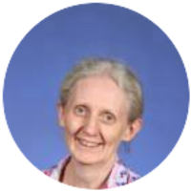
Staffing
Year 6 2024-25
Mr John Spinks
Class Teacher / Deputy Head
Mrs Tifa Hall
Learning Support
Mrs Jane Wiles
Class Teacher Tuesday
Miss Jill Oddy
Class Teacher Wednesday
Mrs An Joul
Class Teacher Thursday

Slide 7
Weekly Events
Day | Event
Monday | Booster maths groups are on Mondays from 3.15 to 4.30. The booster group for maths started on 9th September | Homework set
Tuesday |  | Homework set
Wednesday | PE (wear kit) | Homework set
Thursday | PE (wear kit) | Homework set
Friday | Achievement assembly
Please note that for PE, earrings (studs only) need to be removed once the ears have been pierced for 6 months. If your child cannot do this unaided, please send them in without earrings on PE days. Pupils with newly pierced ears will be required to tape up their ears during PE lessons for safety reasons.

Slide 8
Topics this term.
English: This is taught each day. Over the year there will be continued focus on grammar, writing skills, spelling and extended writing. We will do guided reading comprehension-style questions in Year 6 too. The text types that we are focusing on this term are: poetry, non-chronological reports, recounts and adventure stories. We are expecting that most of the children reach age related expectations in English skills and we will be supporting and giving work to help with this.
Although the children are older and have learnt to read, it is still vitally important to talk to them about their reading and share books and stories together. Sustained reading and skimming and scanning for information are important skills ready for high school, which can be practiced at home by reading for at least 10 minutes each night. It does work! Ask last year’s class!
Maths: This is taught each day. This half-term we begin with number; specifically, place value, addition/ subtraction, multiplication and division skills. We will also have an investigations and problem solving which require the children to think, question, reason and apply skills they have learnt. We aim to make them all confident and logical in their approach to work.
We will also have a mental maths target this half term which will be: multiplying and dividing any number by 10, 100, 1000.
You can help by supporting your child to learn and remember addition/subtraction bonds, any times tables they do not know and sharing with them real-life applications of maths e.g. reading gas/electricity meters, looking at phone bills, weighing out ingredients for recipes.

Slide 9
Topics this term.
Science: Human bodily systems. Living things and their habitats. Geography: Brazil – would you rather live in Brazil or Britain?
History: What was South America like in the past- who were the Maya? RE: Sikhism and how we celebrate special occasions. PSHE: Friendships, new starts and thinking hats. Art: Drawing and mark making Computing: Online safety. Computer systems and coding. Music: Ukuleles.
PE: Athletics, dance and yoga.

Slide 10
Homework
Reception
Parents and carers are encouraged to share books together with a reading book sent home to be read daily.
Maths work may also be sent home once a week.
Home phonics packs for daily practice
Years 1 and 2
1 hour per week which will include Reading, Spelling/ Phonics, other English and Maths work / topic work
Reading at home 4 or 5 times a week for 10/15 minutes
Years 3, 4 and 5
1.5 hours per week which will include Reading, Spelling, other English and Maths work with occasional tasks in other subjects
Reading at home which may include online reading activities
Phonics or extra maths from boosters may be also set for groups or individuals
Year 6
30 minutes four times a week, Regular weekly schedule with continued emphasis on English and maths, but also ranging widely over the curriculum. Set Monday to Thursday and due in the following day.
The websites below will also give you further helpful information:
http://www.nnparenttoolkit.org.uk/information-for-parents/ (Maths)
http://www.theschoolrun.com/ (Maths, Literacy and other primary subjects)
It is REALLY IMPORTANT for children to learn any times tables they still aren’t confident about- we are still subscribing to TTrock stars and children should access this at least twice a week at home. They also need to be able to tell the time accurately using digital and analogue clocks, as this is a life skill.

Slide 11
Possible trips and events
We are very hopeful that we will be able to support learning with a range of exciting trips, visits and activities this year. Under consideration are:
A trip to Tropical World.
A trip to Armley Mills.
Residential to Bewerley park.
Taking part in Bikeability.
Preparing for high school.
A trip to Leeds RERF.
A trip to Whitby.

Slide 12
Uniform
We now have an established local supplier for school uniform based in Harehills – Uniwears.
Pupils need to wear PE kit on their PE days.

Slide 13
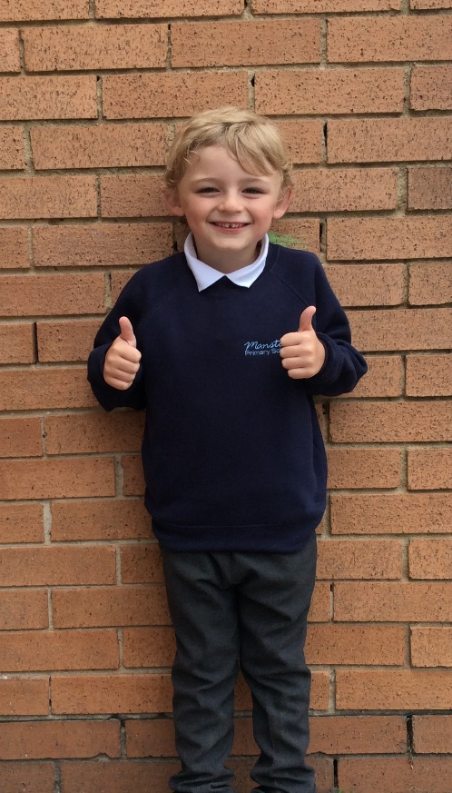
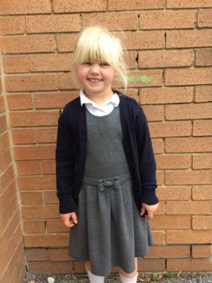
Uniform
Navy school jumper (with or without logo)
Navy school cardigan (with or without logo)
White polo shirt or shirt
Grey school trousers/skirt
Grey school dress
Blue checked school summer dress
Grey school shorts
Black shoes or trainers that children can fasten independently e.g. Velcro
Long hair must be tied up / no extreme hair styles
PE Kit (worn on PE days)
Team coloured t-shirt
Black or grey PE shorts
or
Black or grey jogging bottoms or leggings
Navy hooded top

Slide 14
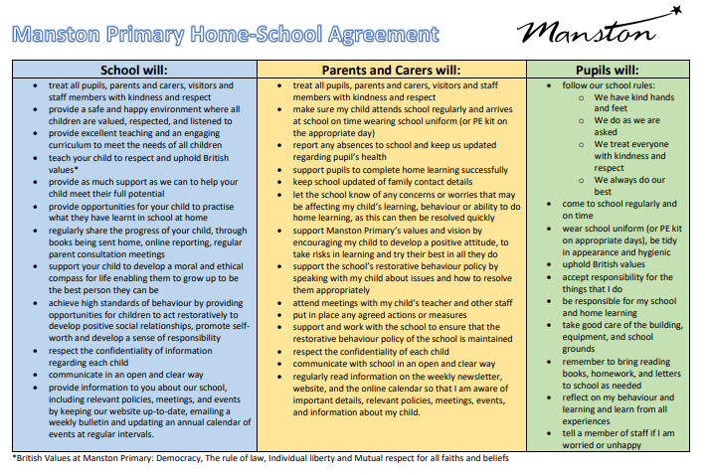
Home School Agreement
This sets out school's expectations of staff, pupils and parents and carers.
Please read this document carefully as it applies to everyone at our school.
If you would like a paper copy of this, please let me know.

Slide 15
Equipment
Each day children will need to bring:
A named water bottle
Named coats, hats, gloves suitable to the weather
Homework
Reading book
Pupils do not need:
Pencil cases
Toys or games

Slide 16
Internet Safety
We are committed to promoting internet safety and safe use of social media. We teach this in school but ask for parental support in this matter.
For further information, please refer to the 'Online Safety' section of the school website, under the parents tab.

Slide 17
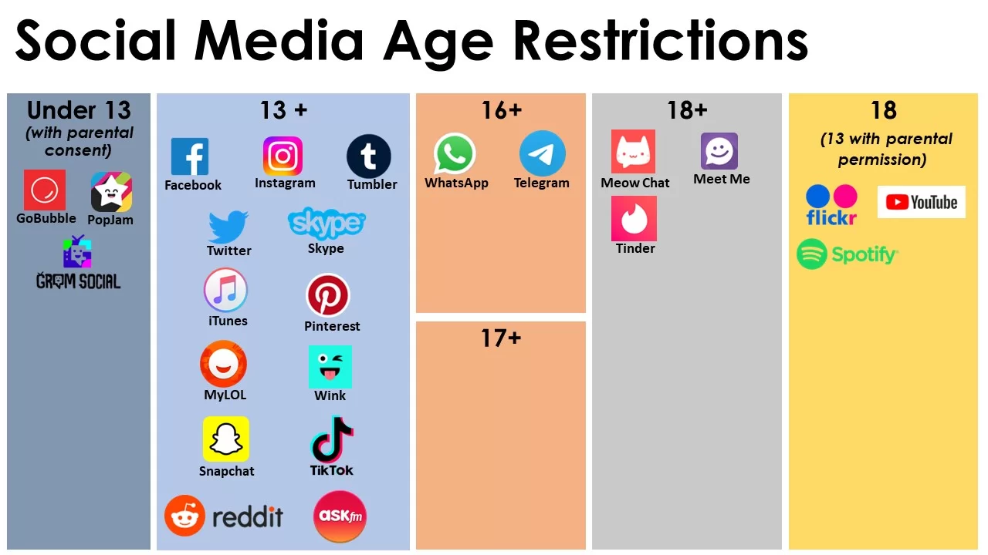
Internet Safety

Slide 18
Attendance.
Our pupils have excellent attendance, and this is something we want to keep improving.
If your child is absent, please ring, email or speak with a member of staff in the office to let them know the details of the absence.
Please be reminded that school cannot authorise holidays in term time and any applications for exceptional leave must be made by filling in a form from the office.
School starts at 08:50 am each day and finishes at 3:15pm
Further details including our full policy can be found on our school website.

Slide 19
Restorative Behaviour
Restorative Practices Philosophy Statement
Effective Restorative Practices foster awareness of how others have been affected by inappropriate behaviour. This is done by actively engaging participants in a process which separates the deed from the doer and rejects the act not the actor, allowing participators to make amends for the harm caused. Restorative Practices acknowledges the intrinsic worth of the person and their potential contribution to the school community.
Restorative Practices framework will:
Improve behaviour and attitudes
Provide explicit tools within a defined framework to challenge unacceptable behaviour, resolve conflict and repair harm
Improve relationships, establish rights, accountabilities and responsibilities to the community
Provide a safe, philosophical basis for staff, pupils and parents to share ideas and discuss issues

Slide 20
Frequently Asked Questions
When can I apply for a place at High School Year 7?
The application process is available from 1st August 2024 to 31 October 2024 for Year 6 children.
How do I apply for a place?
You can apply online by going to www.leeds.gov.uk/admissions and searching for secondary admissions. If you need assistance with the application you can call 0113 2224414 or email startingsecondary@leeds.gov.uk
When are SATs?
SATs this year are the week of the 12th May so PLEASE do not book a holiday during this time as it is really important that your child is able to take the tests.
How can I help my child prepare for SATs and high school?
Encourage and support them to complete homework.
Encourage them to take responsibility for themselves and their belongings: PE kit, homework, letters etc
Support them in learning tables and number bonds.
Be interested in what they are reading and talk with them about the books.
When do you do relationship and sex education?
This is done in the summer term, starting after SATs. A letter will be sent to parents first with details of what will be taught. We feel it is really important that children are given clear teaching of this topic rather than hearing it inaccurately from their peers.

Slide 21
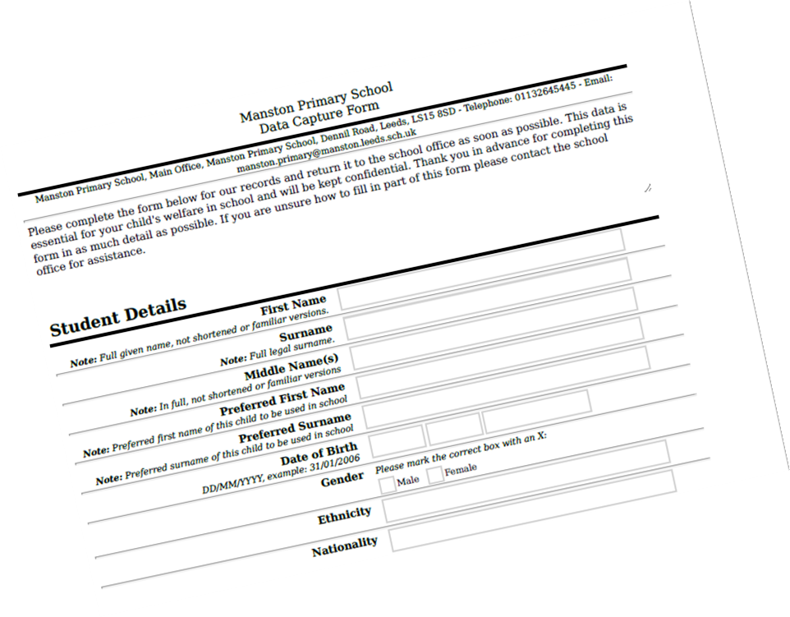
Data Checking
Please check/update the details we hold for your child to ensure we have:
At least 2 emergency contacts.
Current emails/ addresses.
Up to date medical information.

Slide 22
Any Questions?
School Email: manston.primary@manston.leeds.sch.uk
Class teacher email: john.spinks@manston.leeds.sch.uk
Do not hesitate to get in touch if you have any questions or need some support.

