Slide 1
Meet the teacher
September 2024

Slide 2
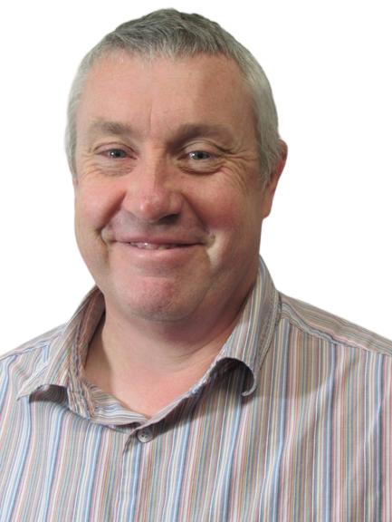
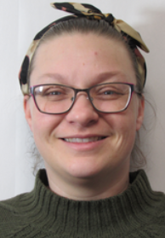
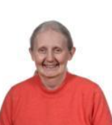
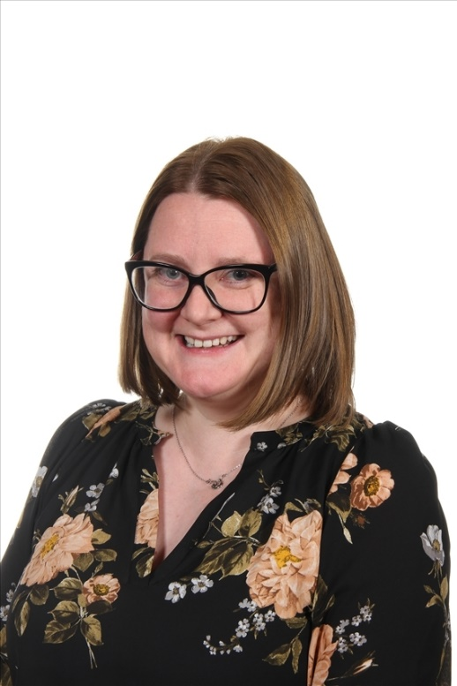
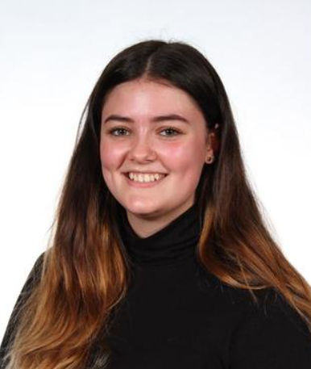
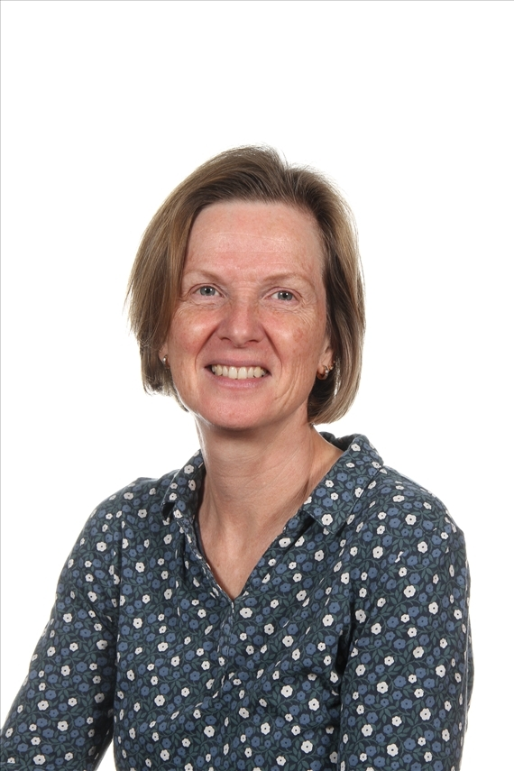
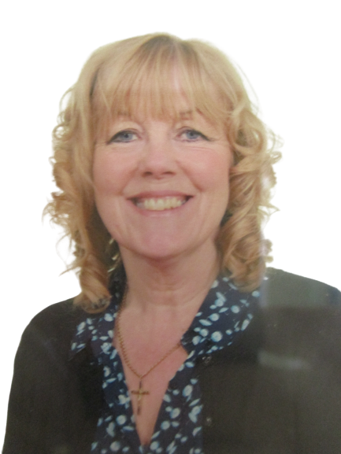
Staffing
Year 4 2024-25
Miss Turnbull and Mrs Wiles
Mr Delahaye-
Learning Support
Mrs Meah
Class Teacher
Mon-Wed
Mrs Dutton-Waugh
Class Teacher
Currently on MAT leave Wed-Fri
Mrs Cartwright
HLTA – Wednesday afternoon
Mrs Batty Thursday &
Friday until Mrs DW returns

Slide 3
Child protection Staff

Slide 4
Daily timings
School starts at 08:50 am every day
Classroom doors will be open from 08:45 and pupils are invited to come straight inside
School ends at 03:15 pm every day
Break time for this class is at 10.40
Lunch time for this class is at 12.15 (except on Wednesday it will be 12pm due to swimming)

Slide 5
Timetable
Day | Lesson 1 | Break | Lesson 2 | Lunch | Lesson 3 | Lesson 4
Monday | Assembly/Maths |  | English/GR |  | Humanities | Art/DT
Tuesday | Class assembly/Maths |  | English/GR |  | French/PSHE | Computing
Wednesday | Singing assembly/Maths |  | English GR |  | PE-Swimming | RE
Thursday | KS2 assembly/Maths |  | English/GR |  | Science | PE
Friday | Maths / GR |  | English |  | Music | Assembly

Slide 6
Weekly Events
Day | Event
Monday | Paper homework due | Online TTRS homework set/reset day
Tuesday |  | Homework set
Wednesday | PE (Swimming wear kit under PE kit)
Thursday | PE (wear kit)
Friday |  | Achievement assembly
Please note that for PE earrings (studs only) need to be removed once the ears have been pierced for 6 months. If your child cannot do this unaided please send them in without earrings on PE days. Pupils with newly pierced ears will be required to tape up their ears during PE lessons for safety reasons.

Slide 7
Topics this term.
English:This is taught each day. Over the year there will be continued focus on grammar, writing skills, spelling and extended writing. We will do guided reading each day. The text types that we are focusing on this term are: poetry, recounts and narrative story telling.
Wonderverse poetry – riddles, Kennings and acrostic
“The Hodgeheg” by Dick King-Smith – work based around this book
“Christophe’s Story” by Nicki Cornwell – work based around this book
Poetry – Haiku
Guided Reading, Y4 Comprehension (Pearson Active Learn – online access to texts at home available)
Spelling & Grammar work
Although the children are older and have mostly learnt to read, it is still vitally important to talk to them about their reading and share books and stories together. This helps them develop their skills and a love of reading. Sustained reading and skimming and scanning for information are important skills ready for high school, which can be practiced at home by reading for at least 10 minutes each night . It does work!
We are expecting that most of the children reach age related expectations in English skills and we will be supporting and giving work to help with this.

Slide 8
Maths: This is taught each day. This is taught each day. This half
term we begin with number; specifically, place value, addition/ subtraction, multiplication and
division skills. We will also have investigations and problem solving which require the children to think, question, reason and apply skills they have learnt. We aim to make them all confident and logical in their approach.
Maths No Problem
Early Bird Maths / intervention groups.
You can help by supporting your child to learn and remember addition/subtraction bonds, any times tables they do not know and sharing with them real life applications of maths eg. reading
gas/electricity meters, looking at phone bills, weighing out ingredients for recipes.
Ensuring children are confident with telling the time on digital and analogue clocks is vital too.

Slide 9
Topics this term.
Science: 1. Habitats. 2. Electricity. ​ Geography: 1. How can we use maps and photos to identify local changes over time?​
2. Where would you settle in Ancient England?​
RE: Important Events. (Following Leeds SOW)​ PSHE: 1. Identity, society and equality: Democracy. 2. Drug, alcohol and tobacco education: Making choices​
Art: John Atkinson Grimshaw. Using old photos of Leeds to sketch. Using cameras and sketches to record our environment.​
DT: Structures-Pavilions Computing: Tuesday: Computer networks and systems, Collaborative learning /Online safety lesson 1​ Music: Descant recorders/musical notation, singing. ​
PE: Swimming each week. 1. Ball skills, movement/using apparatus and skipping skills ​
2. Agility, Balance and Coordination.​

Slide 10
Homework
Reception
Parents and carers are encouraged to share books together with a reading book sent home to be read daily.
Maths work may also be sent home once a week.
Home phonics packs for daily practice
Years 1 and 2
1 hour per week which will include Reading, Spelling/ Phonics, other English and Maths work / topic work
Reading at home 4 or 5 times a week for 10/15 minutes
Years 3, 4 and 5
1.5 hours per week which will include Reading, Spelling, other English and Maths work with occasional tasks in other subjects
Reading at home which may include online reading activities
Phonics or extra maths from boosters may be also set for groups or individuals
Pupils who do not complete homework will be given time/help to do this the following playtime.
Year 6
30 minutes four times a week, Regular weekly schedule with continued emphasis on English and maths, but also ranging widely over the curriculum. Set Monday to Thursday and due in the following day.
Pupils who do not complete homework will be given time/help to do this the following playtime.
The websites below will also give you further helpful information:
http://www.nnparenttoolkit.org.uk/information-for-parents/ (Maths)
http://www.theschoolrun.com/ (Maths, Literacy and other primary subjects)
It is REALLY IMPORTANT for children to learn any times tables they still aren’t confident about- we are still subscribing to TTrock stars and children should access this at least twice a week at home. They also need to be able to tell the time accurately using digital and analogue clocks, as this is a life skill.

Slide 11
Possible trips and events
Hopefully, we will be able to go on trips and take part in lots of exciting activities this year. These could include:
A trip to Skelton Grange for our science topic
Taking part in cycle sense
Local area walk
Trip in Summer linked with our history topic

Slide 12
Uniform
Branded school uniform can be purchased from – Uniwears.
https://www.uniwears.co.uk/products/manston-primary-school-sweatshirt?_pos=3&_sid=7b719498d&_ss=r&variant=47855109734745
Non branded dark blue versions of jumpers and cardigans are also fine for children to wear.
Pupils need to wear PE kit on their PE days including those that go swimming

Slide 13
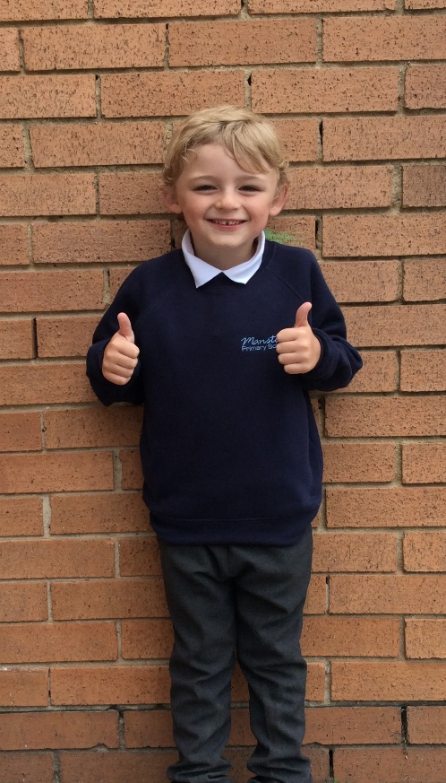
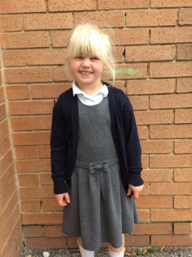
Uniform
Navy school jumper (with or without logo)
Navy school cardigan (with or without logo)
White polo shirt or shirt
Grey school trousers/skirt
Grey school dress
Blue checked school summer dress
Grey school shorts
Black shoes or trainers that children can fasten independently e.g. Velcro
Long hair must be tied up / no extreme hair styles
PE Kit (worn on PE days)
Team coloured t-shirt
Black or grey PE shorts
or
Black or grey jogging bottoms or leggings
Navy hooded top with logo

Slide 14
Communication
School communicates through email, text messages and sometimes paper letters.
Each Friday, a weekly newsletter comes home with details of all that is going on in school.
Class teachers will also email to share specific information and updates.
School can list 2 numbers as priority one contacts so that both parents receive any general text messages sent.
Please add the following emails to your contacts so that emails come straight to your inbox:
manston.primary@manston.leeds.sch.uk
no-reply@mail.arbor-education.com

Slide 15
Home School Agreement
An updated copy of this, including an online safety pupil user agreement has come home recently.
Please review this at home with your child.
This agreement applies to all pupils, parents and staff at Manston Primary

Slide 16
Equipment
Each day children will need to bring:
A named water bottle
Named coats, hats, gloves suitable to the weather
Homework
Reading book
Pupils do not need:
Pencil cases
Toys or games
School staff will not spend time looking for items that are not named.

Slide 17
Attendance.
Our pupils have excellent attendance, and this is something we want to keep improving.
If your child is absent, please ring, email or speak with a member of staff in the office to let them know the details of the absence.
Please be reminded that school cannot authorise holidays in term time and any applications for exceptional leave must be made by filling in a form from the office.
School starts at 08:50 am each day and finishes at 3:15pm
Further details including our full policy can be found on our school website.
Please note that new legislation about term time holidays came into force in August 2024.

Slide 19
Frequently Asked Questions
What is the MTC?​
The MTC is an on-screen check (test) consisting of 25 times tables questions. Your child will answer 3 practice questions before moving on to the official check and will then have 6 seconds to answer each question. On average, the check should take no longer than 5 minutes to complete.​
https://www.gov.uk/government/collections/multiplication-tables-check ​
The purpose of the check is to determine whether pupils can fluently recall their times tables up to 12, which is essential for future success in mathematics. The test is compulsory for all Y4 children in England. ​
​
When do you teach relationship and sex education (RSE)? ​
This is taught in the summer term, in July. A letter will be sent to parents beforehand, confirming details of what will be taught. ​
​
In Y4 the focus is on how our bodies change as we become adults. We feel it is really important that children are given clear teaching of this topic rather than hearing it inaccurately from their peers. ​

Slide 20
Data Checking
Please check/update the details we hold for your child to ensure we have:
At least 2 emergency contacts
Current emails/ addresses
Up to date medical information
You can do this by emailing the school office or updating details on the Arbor App.

Slide 21
Any Questions?
School Email: manston.primary@manston.leeds.sch.uk
Class teacher email: kerri.meah@manston.leeds.sch.uk
rachel.batty@manston.leeds.sch.uk
maisy.Dutton@manston.leeds.sch.uk
Do not hesitate to get in touch if you have any questions or need some support.

