Slide 1
Meet the teacher
September 2024

Slide 2
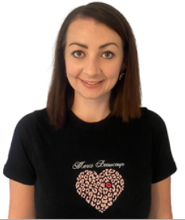
Staffing
Year 1 2024-25
Mrs Lucy Millington
Class Teacher / Assistant Head Teacher
Mrs Michelle Barratt
Learning Support
Miss Rebecca Pearce
Learning Support

Slide 3
Child protection Staff

Slide 4
Daily timings
School starts at 08:50 am every day
Classroom doors will be open from 08:45 and pupils are invited to come straight inside
School ends at 03:15 pm every day
Break time for this class is at 10.15
Lunch time for this class is at 11:55

Slide 5
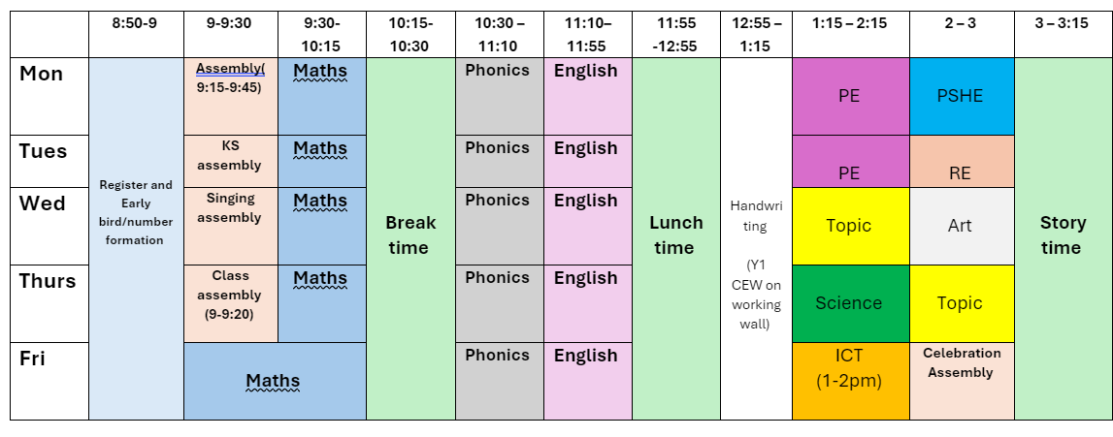
Timetable

Slide 6
Weekly Events
Day | Event
Monday | PE (wear kit)
Tuesday | PE (wear kit)
Wednesday
Thursday
Friday
Please note that for PE earrings (studs only) need to be removed once the ears have been pierced for 6 weeks. If your child cannot do this unaided please send them in without earrings on PE days. Pupils with newly pierced ears will be required to tape up their ears during PE lessons for safety reasons.

Slide 7
Topics this term.
Phonics: This is taught each day with a focus on reading and the application of learned phonics sounds to aid with spelling as well as reading and writing sentences. There will be ongoing phonics intervention sessions with the LSAs in class as well as daily reading. Please try and read with your child daily – if only for 10 minutes. This will support what we are doing in class as well as promoting a love of reading.
English: This is taught each day. Our English lessons tend to tie in with our Topic of the half term. For Autumn 1, we will be looking at the story Owl Babies where we will retell and rewrite the story and then have a go at writing our own story based on a nocturnal animal. The main focus here will be constructing sentences, the application of phonics and presentation.
Maths: This is taught each day. This half-term we begin with place value and number. Maths is still very practical as we introduce some more formal methods. Word problems are also included to improve problem solving and reasoning.

Slide 8
Topics this half term (Autumn 1).
Science: Identifying animals Geography: Human and physical features – our local area
History: Houses/homes past and present RE: Special books and stories PSHE: Family and relationships Art/DT: Make your mark – use a range of mediums to create different types of marks. Computing: Computing systems and networks: Improving mouse skills Music: Pulse and rhythm
PE: Fundamentals and team building

Slide 9
Homework
Years 1 and 2
1 hour per week which will include Reading, Spelling/ Phonics, other English and Maths work / topic work
Reading at home 4 or 5 times a week for 10/15 minutes
You should have all been provided with TTRS and Bug Club log ins this academic year. If you have not got this, or need it again, please let me know and I can sort asap!
The websites below will also give you further helpful information:
http://www.nnparenttoolkit.org.uk/information-for-parents/ (Maths)
http://www.theschoolrun.com/ (Maths, Literacy and other primary subjects)
It is REALLY IMPORTANT for children to learn any times tables they still aren’t confident about- we are still subscribing to TTrock stars and children should access this at least twice a week at home. They also need to be able to tell the time accurately using digital and analogue clocks, as this is a life skill.

Slide 10
Possible trips and events
Hopefully, we will be able to go on trips and take part in lots of exciting activities this year. These could include:
A local walk and trip to the Library (Autumn 1) - Geography
Abbey House Museum (Autumn 2) - History
Lillie Timmons visitor (Spring 2) - Art
Poppins Presentation Visitor (Summer 1) - English
Lotherton Hall (Summer 2)
KS1 Reward – Forest School session

Slide 11
Uniform
Branded school uniform can be purchased from – Uniwears.
https://www.uniwears.co.uk/products/manston-primary-school-sweatshirt?_pos=3&_sid=7b719498d&_ss=r&variant=47855109734745
Non branded dark blue versions of jumpers and cardigans are also fine for children to wear.
Pupils need to wear PE kit on their PE days including those that go swimming.
It is really helpful if jumpers, coats, etc. are named to reduce the likelihood of these items getting lost.

Slide 12
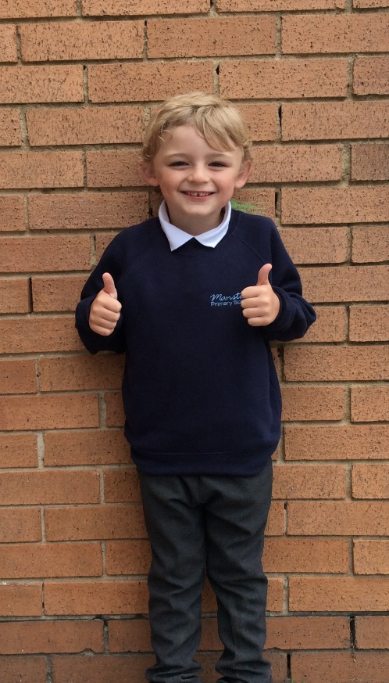
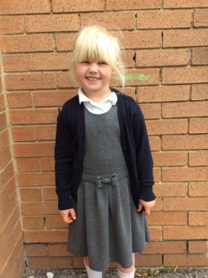
Uniform
Navy school jumper (with or without logo)
Navy school cardigan (with or without logo)
White polo shirt or shirt
Grey school trousers/skirt
Grey school dress
Blue checked school summer dress
Grey school shorts
Black shoes or trainers that children can fasten independently e.g. Velcro
Long hair must be tied up / no extreme hair styles
PE Kit (worn on PE days)
Team coloured t-shirt
Black or grey PE shorts
or
Black or grey jogging bottoms or leggings
Navy hooded top with logo

Slide 13
Communication
School communicates through email, text messages and sometimes paper letters.
Each Friday, a weekly newsletter comes home with details of all that is going on in school.
Class teachers will also email to share specific information and updates.
School can list 2 numbers as priority one contacts so that both parents receive any general text messages sent.
Please add the following emails to your contacts so that emails come straight to your inbox:
manston.primary@manston.leeds.sch.uk
no-reply@mail.arbor-education.com

Slide 14
Home School Agreement
An updated copy of this, including an online safety pupil user agreement has come home recently.
Please review this at home with your child.
This agreement applies to all pupils, parents and staff at Manston Primary

Slide 15
Equipment
Each day children will need to bring:
A named water bottle
Named coats, hats, gloves suitable to the weather
Homework
Reading book
Pupils do not need:
Pencil cases
Toys or games
School staff will not spend time looking for items that are not named.

Slide 16
Attendance.
Our pupils have excellent attendance, and this is something we want to keep improving.
If your child is absent, please ring, email or speak with a member of staff in the office to let them know the details of the absence.
Please be reminded that school cannot authorise holidays in term time and any applications for exceptional leave must be made by filling in a form from the office.
School starts at 08:50 am each day and finishes at 3:15pm
Further details including our full policy can be found on our school website.
Please note that new legislation about term time holidays came into force in August 2024.

Slide 18
Frequently Asked Questions
What is the Phonics Screening Check and how can I support my child?
How is learning in Year 1 different from Reception?

Slide 19
Data Checking
Please check/update the details we hold for your child to ensure we have:
At least 2 emergency contacts
Current emails/ addresses
Up to date medical information
You can do this by emailing the school office or updating details on the Arbor App.

Slide 20
Any Questions?
School Email: manston.primary@manston.leeds.sch.uk
Class teacher email: lucy.millington@manston.leeds.sch.uk
Do not hesitate to get in touch if you have any questions or need some support.

