Slide 1
Meet the teacher
September 2024

Slide 2
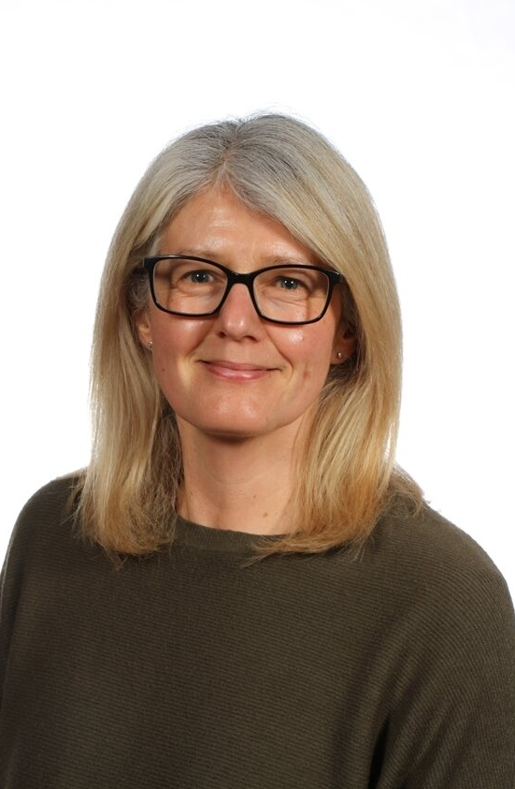
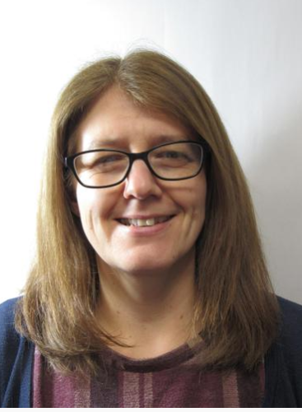
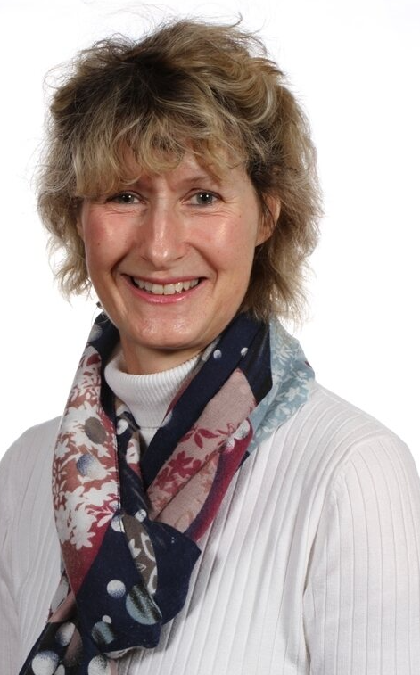
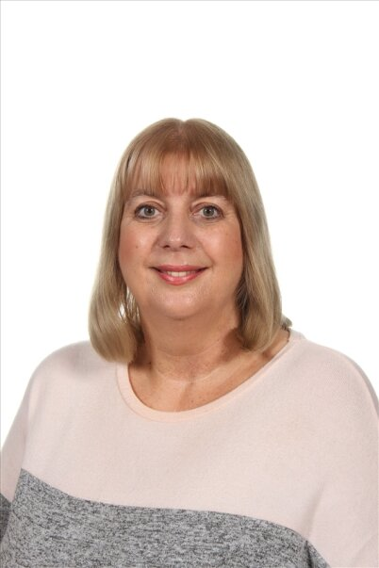
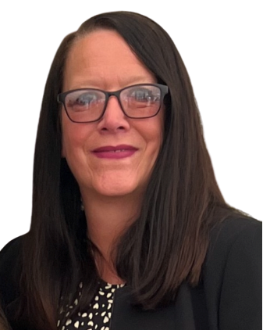
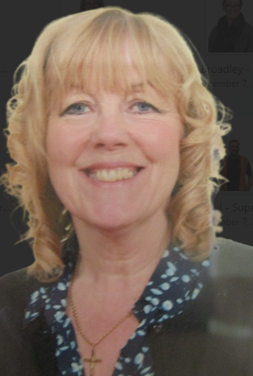
Staffing
Year 2 – 2023-24
Mrs Smith
LSA Monday, Tuesday, Wednesday & Thursday
Mrs Jennings
Teacher
Mrs Cartwright
Teacher on Monday PM
Miss Oddy
LSA Friday
Mrs Joul
LM on Tuesday am Thursday am

Slide 3
Child protection Staff

Slide 4
Daily timings
School starts at 8:50 am every day
Classroom doors will be open from 08:45 and pupils are invited to come straight inside
School ends at 3:15 pm every day
Break times for this class are at 10:15am and between 2/2:30pm
Lunch time for this class is at 11:55am

Slide 5
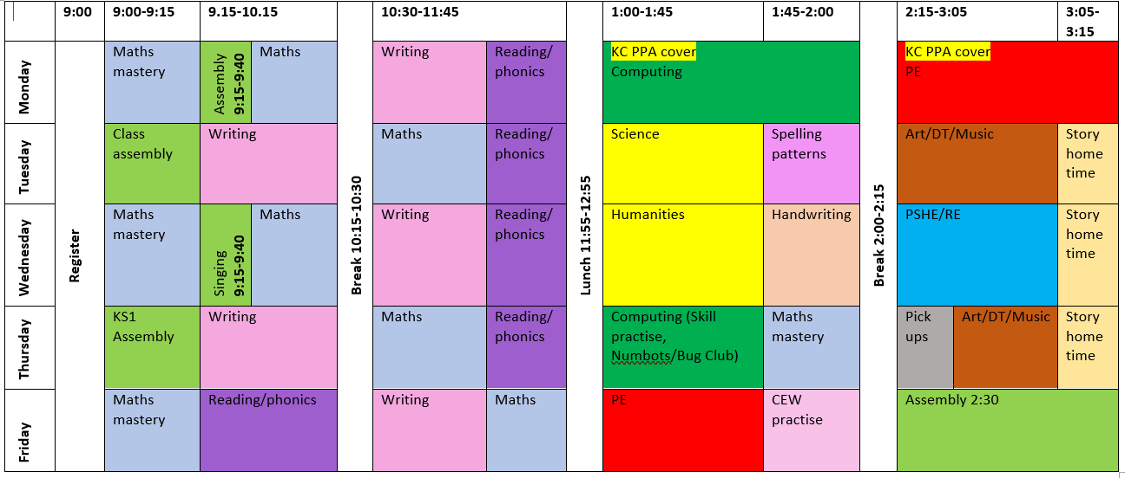
Timetable

Slide 6
Weekly Events
Day | Event
Monday | PE (wear kit)
Tuesday
Wednesday
Thursday |  | Homework due
Friday | PE (wear kit) | Homework set Achievement assembly
Please note that for PE earrings (studs only) need to be removed once the ears have been pierced for 6 months. If your child cannot do this unaided please send them in without earrings on PE days. Pupils with newly pierced ears will be required to tape up their ears during PE lessons for safety reasons.

Slide 7
Topics this term.
Phonics:
This is taught daily for the Autumn term, focusing on reading one day and writing the next. There will be ongoing phonic interventions for children who did not pass the PSC in year 1 and daily reading. Please try to read with your child for 5-10 minutes each day as this will support what we are doing in class and promote a love of reading.
English:
This is taught each day. Over the year there will be a continued focus on grammar, writing skills, spelling, and reading. We will learn a new text each half term that we will imitate, innovate and invent our own stories, letters, diaries, and reports. The text types that we are focusing on this term are; retelling a story, non-fiction (recount) We expect most of the children to reach age-related expectations in English skills.

Slide 8
Topics this term.
Maths:
This is taught each day. This half-term we begin with number; specifically numbers to 100, place value and addition/subtraction.
Activities in maths lessons will require the children to think, question and apply skills they have. We aim to make them all confident and logical in their approach to work.
We expect most of the children to reach age-related expectations in Maths skills. ​

Slide 9
Topics this term.
Science: Habitats Geography: Oceans and Continents, Antarctica
History: Ernest Shackleton, Black History (Black History month in October) RE: How can we make good choices?
PSHE: Mental health, wellbeing and friendships
Art: Colour mixing, primary and secondary colours, painting Computing: Online Safety, learning about computer skills Music: Charanga online music resource
PE: Practising and enhancing basic skills, teambuilding (PE will be on Monday pm and Friday pm – wear PE kit to school)

Slide 10
Homework
Years 1 and 2
1 hour per week which will include Reading, Spelling/Phonics, other English and Maths work or topic work
Reading at home 4 or 5 times a week for 5/10/15 minutes
You should have all been provided with TTRS and Bug Club log ins. If you have not got this, or need it again, please let me know and I can sort asap!
The websites below will also give you further helpful information: ​
http://www.nnparenttoolkit.org.uk/information-for-parents/ (Maths) ​
http://www.theschoolrun.com/ (Maths, Literacy and other primary subjects) ​
Children need to learn any times tables they still aren’t confident about- we are still subscribing to TTrock stars and children should access this at least twice a week at home. They also need to be able to tell the time accurately using digital and analogue clocks, as this is a life skill.

Slide 11
Homework
Homework will consist mainly of spelling practice, reading, an English task and a Maths task.
Additional homework may be set to do some extra Numbots practise.
Homework may increase each term as children get more used to the routine of completing it.
Children should read for pleasure for at least 5-10 minutes each night.
You can support your child by reading with them, showing an interest in their work and encouraging them to complete any set tasks punctually.
We expect all children to have a go at homework that is set. We will discuss tasks before they go home but if your child is uncertain, please feel free to explain it or re-direct them back to us for some help.
Completed homework that is handed in on time earns children 5 dojo points.

Slide 12
Possible trips and events
Hopefully, we will be able to go on trips and take part in lots of exciting activities this year.
These could include:
Local walk to the library
Local area walk
Ponderosa zoo
Workshops
KS1 Reward for holiday homework – Forest school activities.

Slide 13
Uniform
Branded school uniform can be purchased from– Uniwears.
https://www.uniwears.co.uk/products/manston-primary-school-sweatshirt?_pos=3&_sid=7b719498d&_ss=r&variant=47855109734745
Non-branded dark blue versions of jumpers and cardigans are also fine for children to wear.​
Pupils need to wear PE kit on their PE days including those that go swimming.​
A reminder of school uniform is included on weekly newsletters
It is helpful if jumpers, coats, etc. are named to reduce the likelihood of these items getting lost.

Slide 14
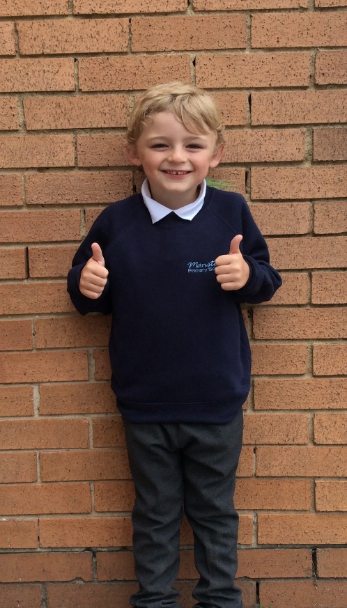
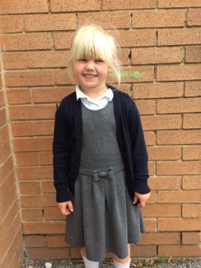
Uniform
Navy school jumper (with or without logo)
Navy school cardigan (with or without logo)
White polo shirt or shirt
Grey school trousers/skirt
Grey school dress
Blue checked school summer dress
Grey school shorts
Black shoes or trainers that children can fasten independently e.g. Velcro
Long hair must be tied up / no extreme hair styles
PE Kit (worn on PE days)
Team coloured t-shirt
Black or grey PE shorts
or
Black or grey jogging bottoms or leggings
Navy hooded top with logo

Slide 15
Communication
School communicates through email, text messages and sometimes paper letters.
Each Friday, a weekly newsletter comes home with details of all that is going on in school.
Class teachers will also email to share specific information and updates.
School can list 2 numbers as priority one contacts so that both parents receive any general text messages sent.
Please add the following emails to your contacts so that emails come straight to your inbox:
manston.primary@manston.leeds.sch.uk
no-reply@mail.arbor-education.com

Slide 16
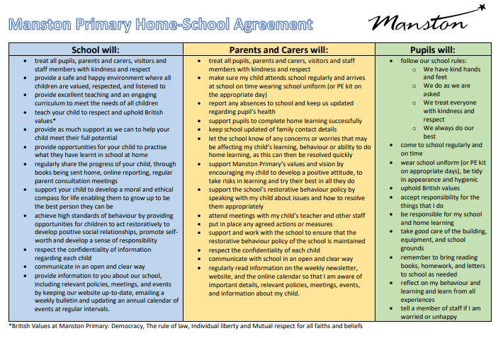
Home School Agreement
An updated copy of this, including an online safety pupil user agreement has come home recently.​
Please review this at home with your child.​
This agreement applies to all pupils, parents and staff at Manston Primary

Slide 17
Equipment
Each day children will need to bring:
A named water bottle
Named coats, hats, gloves suitable to the weather
Homework (due on Thursdays)
Reading book
Pupils do not need:
Pencil cases
Toys or games
School staff will not spend time looking for items that are not named.

Slide 18
Attendance.
Our pupils have excellent attendance, and this is something we want to keep improving.
If your child is absent, please ring, email or speak with a member of staff in the office to let them know the details of the absence.
Please be reminded that school cannot authorise holidays in term time and any applications for exceptional leave must be made by filling in a form from the office. No work will be provided if you take children out during term time.
School starts at 8:50 am each day and finishes at 3:15pm
Further details including our full policy can be found on our school website.
Please note that new legislation about term-time holidays came into force in August 2024.

Slide 20
Restorative Behaviour
Restorative Practices Philosophy Statement
Effective Restorative Practices foster awareness of how others have been affected by inappropriate behaviour. This is done by actively engaging participants in a process which separates the deed from the doer and rejects the act not the actor, allowing participators to make amends for the harm caused. Restorative Practices acknowledges the intrinsic worth of the person and their potential contribution to the school community.
Restorative Practices framework will:
Improve behaviour and attitudes
Provide explicit tools within a defined framework to challenge unacceptable behaviour, resolve conflict and repair harm
Improve relationships, establish rights, accountabilities and responsibilities to the community
Provide a safe, philosophical basis for staff, pupils and parents to share ideas and discuss issues

Slide 21
Frequently Asked Questions
When are SATs?
SATs for Year 2 will no longer take place but children will still be formally assessed to track their progress, this will still take place in May/June.
Please try to avoid booking a holiday during term time as it is important that your child does not fall behind on their learning.
How can I help my child prepare for assessments?
Encourage and support them to complete homework.
Encourage them to take responsibility for themselves and their belongings: PE kit, homework, letters etc
Support them in learning times tables and number bonds.
Be interested in what they are reading and talk with them about the books.
When do you do relationship and sex education?
This is done in the spring term, starting in January. A letter will be sent to parents first with details of what will be taught. We feel it is really important that children are given clear teaching of this topic rather than hearing it inaccurately from their peers. In year 2 we focus on being able to use correct terminology for body parts and look at how our bodies change as we get older. If you have any questions or concerns please feel free to email or make an appointment to speak to me in person after school.

Slide 22
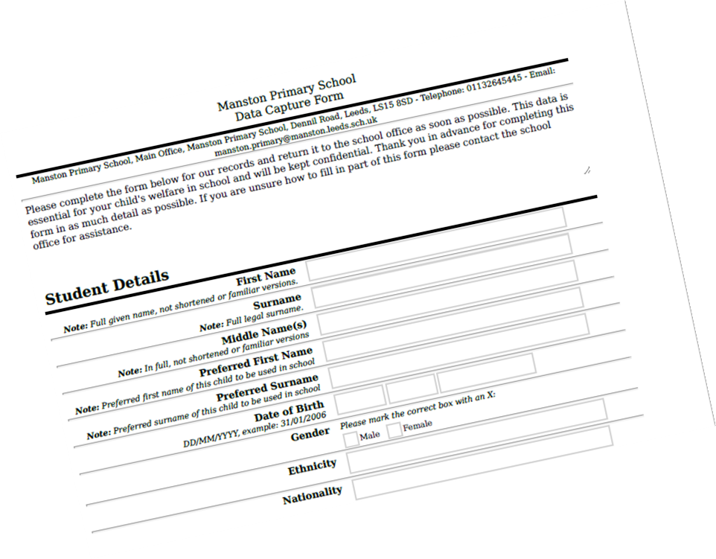
Data Checking
Please check/update the details we hold for your child to ensure we have:
At least 2 emergency contacts
Current emails/ addresses
Up to date medical information
You can do this by emailing the school office or updating details on the Arbor App.​
​

Slide 23
Any Questions?
School Email: manston.primary@manston.leeds.sch.uk
Class teacher email: glenda.jennings@manston.leeds.sch.uk
Do not hesitate to get in touch if you have any questions or need some support.

