Slide 1
Meet the teacher
September 2024

Slide 2
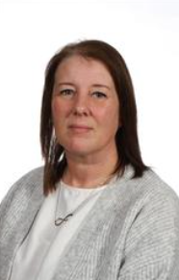
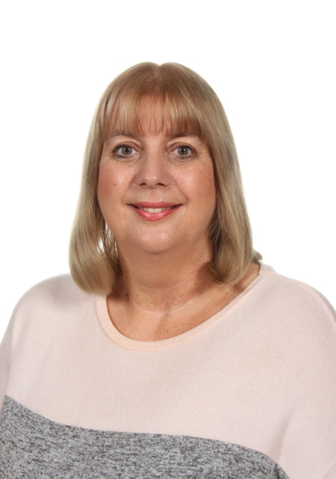
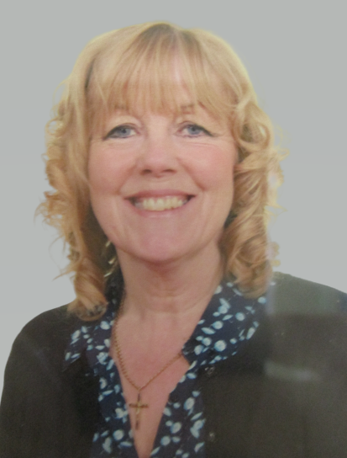
Staffing
Year 3 2024-25
Mrs Joul
HLTA & French– Monday
Mr Everatt
Class Teacher
Miss Fallon
Learning Support
Mrs Cartwright-
Swimming & RE Tuesday PM

Slide 3
Child protection Staff

Slide 4
Daily timings
School starts at 08:50 am every day
Classroom doors will be open from 08:45 and pupils are invited to come straight inside
School ends at 03:15 pm every day
Break time for this class is at 10.15
Lunch time for this class is at 12.15 (11:55 on Tuesday due to swimming)
KS2 have ‘Golden Time’ on a Friday afternoon which is an additional playtime.

Slide 5
Timetable
Day | Lesson 1 | Break | Lesson 2 | Lunch | Lesson 3 | Lesson 4
Monday | Assembly/Guided Reading |  | Maths / English |  | PE | French
Tuesday | Maths |  | English / Guided Reading |  | Swimming | RE
Wednesday | Singing assembly/ Guided Reading |  | Maths / English |  | ICT | History / Geography
Thursday | Maths |  | Guided Reading / English |  | Science | PSHE / Music
Friday | Maths |  | English / Guided Reading |  | Art/DT | Assembly

Slide 6
Weekly Events
Day | Event
Monday | PE (wear kit)
Tuesday | Swimming (wear PE kit with swimwear underneath)
Wednesday
Thursday |  | Homework set / Homework due
Friday |  | Achievement assembly
Please note that for PE earrings (studs only) need to be removed once the ears have been pierced for 6 months. If your child cannot do this unaided please send them in without earrings on PE days. Pupils with newly pierced ears will be required to tape up their ears during PE lessons for safety reasons.

Slide 7
Topics this term.
English:
This is taught each day. We will be focusing on extending the children’s understanding and application of spelling, grammar and punctuation so they can use this to write for different purposes. There will also be a daily guided reading lesson. We will be studying the fiction book ‘While I am sleeping’ and a non-fiction book all about the world’s most extreme environments.
Although the children have learnt to read or are more confident at reading, it is still vitally important to talk to them about their reading and share books and stories together. Sustained reading and looking for key information in the text are vital skills for when they progress through school which can be practiced at home by reading for at least 10 minutes each night. If your child is not yet confident in reading, it is vital that they regularly read at home.
Maths:
This is taught each day. This half-term we begin with number; specifically, place value covering numbers up to 1000. We will be learning how to compose and decompose numbers, compare, order and look for patterns. We will also regularly include problem solving which require the children to think, question, reason and apply skills they have learnt. We aim to make them all confident and logical in their approach to maths.
You can help by supporting your child to learn and remember their addition and subtraction bonds, times table facts and by sharing with them real-life applications of maths e.g. reading gas/electricity meters, looking at phone bills, weighing out ingredients for recipes.

Slide 8
Topics this term.
Science: Rocks, soils and fossils. What is below us?
History: Stone Age to Iron Age.
RE: Judaism and spirituality PSHE: Drug, alcohol and tobacco safety.
Art/DT: Textiles: Design a cushion Computing: Computing systems and networks. Music: Studying and performing the song ‘Let your spirit fly’.
PE: Swimming and team games. PE will be on Monday pm and swimming on Tuesday pm.

Slide 9
Homework
Years 3, 4 and 5
1.5 hours per week which will include Reading, Spelling, other English and Maths work with occasional tasks in other subjects.
Reading at home which may include online reading activities.
Phonics or extra maths from boosters may be also set for groups or individuals.
For Autumn Term, Year 3 will be completing 1 hour of homework per week to ease the transition into KS2. The extra .5 will be introduced in the Spring term.
The websites below will also give you further helpful information:
http://www.nnparenttoolkit.org.uk/information-for-parents/ (Maths)
http://www.theschoolrun.com/ (Maths, Literacy and other primary subjects)
It is REALLY IMPORTANT for children to learn any times tables they still aren’t confident about- we are still subscribing to TTrock stars and children should access this at least twice a week at home. They also need to be able to tell the time accurately using digital and analogue clocks, as this is a life skill.

Slide 10
Possible trips and events
Hopefully, we will be able to go on trips and take part in lots of exciting activities this year. These could include:
Skelton Grange - Stone Age
Library Visit
Leeds City Museum - Ancient Egypt

Slide 11
Uniform
Branded school uniform can be purchased from – Uniwears.
https://www.uniwears.co.uk/products/manston-primary-school-sweatshirt?_pos=3&_sid=7b719498d&_ss=r&variant=47855109734745
Non branded dark blue versions of jumpers and cardigans are also fine for children to wear.
Pupils need to wear PE kit on their PE days including those that go swimming.

Slide 12
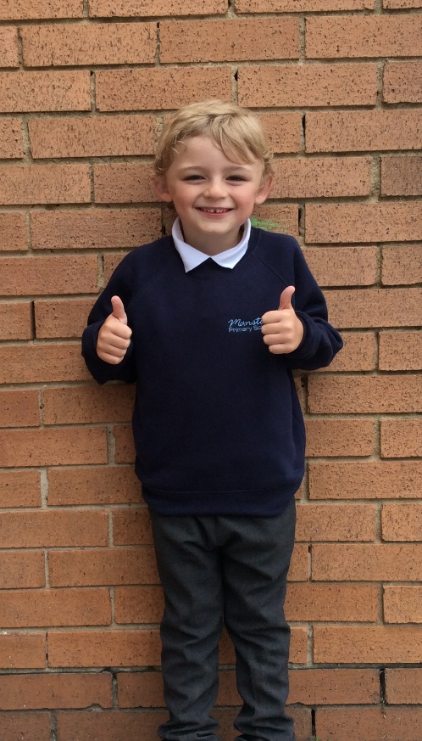
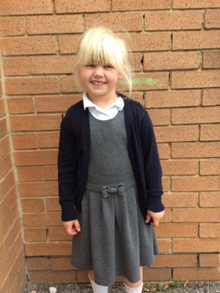
Uniform
Navy school jumper (with or without logo)
Navy school cardigan (with or without logo)
White polo shirt or shirt
Grey school trousers/skirt
Grey school dress
Blue checked school summer dress
Grey school shorts
Black shoes or trainers that children can fasten independently e.g. Velcro
Long hair must be tied up / no extreme hair styles
PE Kit (worn on PE days)
Team coloured t-shirt
Black or grey PE shorts
or
Black or grey jogging bottoms or leggings
Navy hooded top with logo

Slide 13
Communication
School communicates through email, text messages and sometimes paper letters.
Each Friday, a weekly newsletter comes home with details of all that is going on in school.
Class teachers will also email to share specific information and updates.
School can list 2 numbers as priority one contacts so that both parents receive any general text messages sent.
Please add the following emails to your contacts so that emails come straight to your inbox:
manston.primary@manston.leeds.sch.uk
no-reply@mail.arbor-education.com

Slide 14
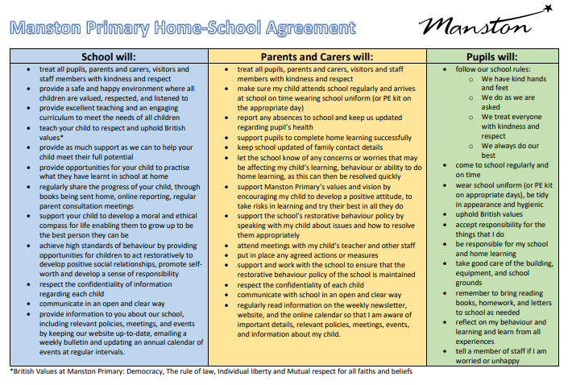
Home School Agreement
An updated copy of this, including an online safety pupil user agreement has come home recently.
Please review this at home with your child.
This agreement applies to all pupils, parents and staff at Manston Primary

Slide 15
Equipment
Each day children will need to bring:
A named water bottle
Named coats, hats, gloves suitable to the weather
Reading book
Pupils do not need:
Pencil cases
Toys or games
School staff will not spend time looking for items that are not named.

Slide 16
Attendance.
Our pupils have excellent attendance, and this is something we want to keep improving.
If your child is absent, please ring, email or speak with a member of staff in the office to let them know the details of the absence.
Please be reminded that school cannot authorise holidays in term time and any applications for exceptional leave must be made by filling in a form from the office.
School starts at 08:50 am each day and finishes at 3:15pm
Further details including our full policy can be found on our school website.
Please note that new legislation about term time holidays came into force in August 2024.

Slide 18
Data Checking
Please check/update the details we hold for your child to ensure we have:
At least 2 emergency contacts
Current emails/ addresses
Up to date medical information
You can do this by emailing the school office or updating details on the Arbor App.

Slide 19
Frequently Asked Questions
What happens on a swimming day?
The children will go for an early lunch so that they are ready to leave school at 1pm. We will sensibly walk from school to John Smeaton in pairs. The children will then arrive at swimming and quickly get changed for a 30 minute session in the pool. There will be different groups in the pool working with an instructor and/or adult. These will be decided later in the term by the swimming instructors and may also change through the year depending on assessments and progress. After the lesson, the children will get changed and walk back to school. This is done within a time limit as the changing rooms need access and there will be a lesson before home time in school. If your child struggles to independently get changed, practising at home with a timer is a great way to support them.
What happens if my child does not bring in their homework?
Homework is part of our school policy and is part of the home school agreement previously mentioned. Getting your child into a routine of doing homework will not only recap previous learning but will also prepare them for when they progress up school and homework is increased. The odd missed homework for important circumstances is understandable however regular missed or late homework will result in your child missing their golden time and you may need to attend a meeting with myself and senior leadership to discuss next steps.
When do you do relationship and sex education?
Year 3 currently do not teach relationship and sex education. If this changes, a letter will be sent to parents first with details of what will be taught.

Slide 20
Any Questions?
School Email: manston.primary@manston.leeds.sch.uk
Class teacher email: alastair.everatt@manston.leeds.sch.uk
Do not hesitate to get in touch if you have any questions or need some support.

