Slide 1

Meet the teacher
September 2026

Slide 2

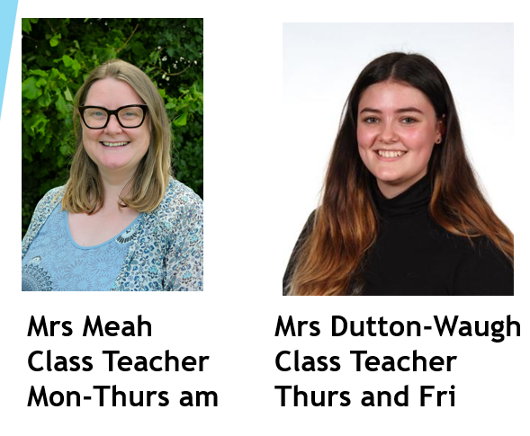
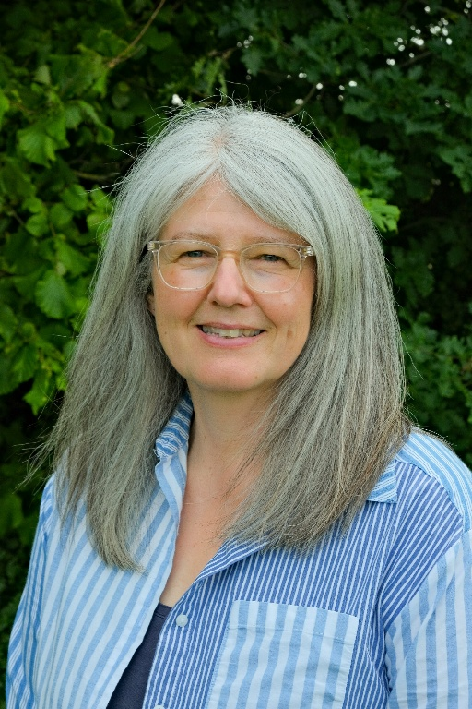
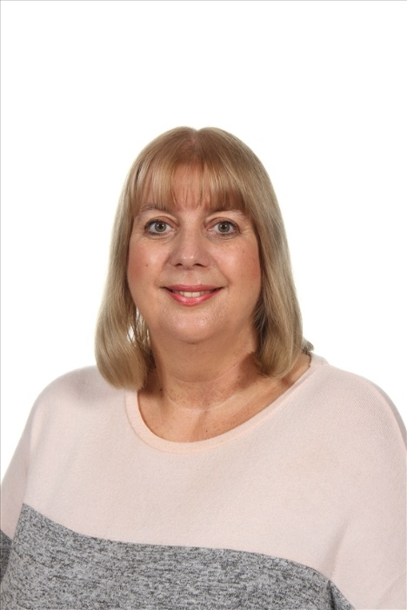
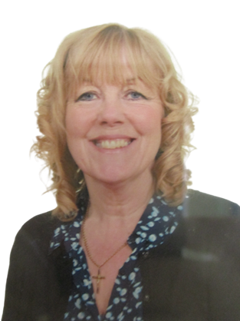
Staffing
Year 6 2026-27
Mrs Joul-
Learning
Support
Fri
Mrs Smith-
Learning Support
Mon-Thurs
Mrs Cartwright-
HLTA- Wed PM

Slide 3
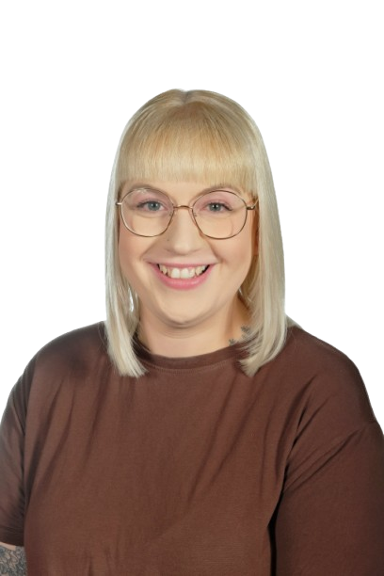
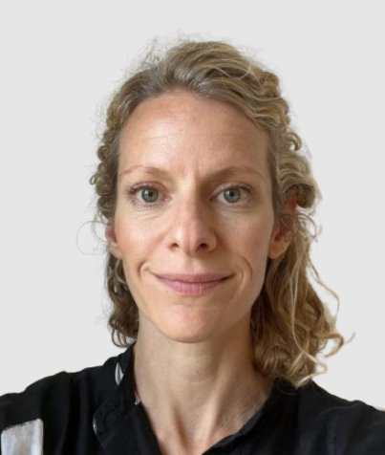
Inclusion Staff
2026-27
Elisabeth Porter
SENDCo
Kirsty Thorpe
Safeguarding and Welfare Officer

Slide 4
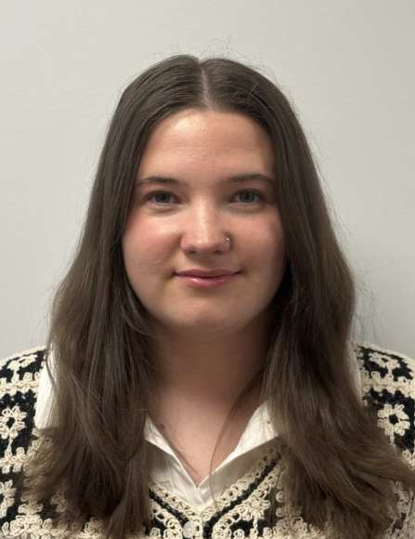
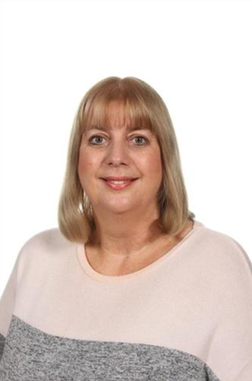
Inclusion Staff
2026-27
Miss Nevill-
Behaviour and Inclusion Officer
Mrs Joul – Learning Mentor

Slide 5

Child Protection Staff

Slide 6
Daily timings
School starts at 08:50 am every day
Classroom doors will be open from 08:45 and pupils are invited to come straight inside
School ends at 03:15 pm every day
Break time for this class is at 10.55
Lunch time for this class is at 12.20

Slide 7
Timetable
Day | Lesson 1 | Break | Lesson 2 | Lunch | Lesson 3 | Lesson 4
Monday | Assembly/Maths |  | English/GR |  | Humanities | Computing
Tuesday | Class assembly/Maths |  | English/GR |  | Art/DT | PSHE
Wednesday | Singing assembly/Maths |  | English GR |  | PE-Swimming | RE
Thursday | KS2 assembly/Maths |  | English/GR |  | PE | Science
Friday | Maths / GR |  | English |  | French/Music | Assembly

Slide 8
Weekly Events
Day | Event
Monday | Paper homework due
Tuesday | Online TTRS homework set/reset day | Homework set
Wednesday | PE (Swimming wear kit under PE kit)
Thursday | PE (wear kit)
Friday |  | Achievement assembly
Please note that for PE earrings (studs only) need to be removed once the ears have been pierced for 6 months. If your child cannot do this unaided please send them in without earrings on PE days. Pupils with newly pierced ears will be required to tape up their ears during PE lessons for safety reasons.

Slide 9


Topics this term.
English: This is taught each day. Over the year there will be continued focus on grammar, writing skills, spelling and extended writing. We will do guided reading each day. The text types that we are focusing on this term are: poetry, recounts and narrative story telling.
Performance poetry – riddles, acrostic and humorous
“The Hodgeheg” by Dick King-Smith – work based around this book
“Christophe’s Story” by Nicki Cornwell – work based around this book
Poetry – Haiku
Guided Reading,
Spelling & Grammar work
Although the children are older and have learnt to read, it is still vitally important to talk to them about their reading and share books and stories together. This helps them develop their skills and a love of reading.

Slide 10
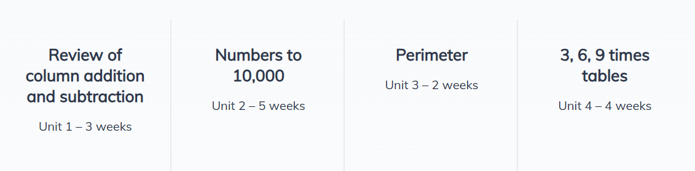
Maths:
This is taught each day.
We use the NCETM scheme with OAK Academy supporting resources to teach Maths.
This half-term we begin with number; specifically numbers to 10,000, place value and addition/subtraction.
Activities in maths lessons will require the children to think, question and apply skills they have. We aim to make them all confident and logical in their approach to work.

Slide 11
Topics this term.
Science: Habitats / Electricity
​
Geography: Fairtrade / Where is Leeds?
​
History: Black History ​
​
RE: ​ How do ancient stories influence modern celebrations? (Following Leeds SOW)​
PSHE: My Healthy Self / Connecting With Others​
​
Art: drawing exploring tone, texture and proportion linked with the artist John Atkinson Grimshaw
DT: Structures
​
Computing: Computing systems and Networks: mouse control​
​
Music: following Charanga on-line music resource planning ​
​
PE: ball skills and agility ​

Slide 12
Homework
Up to 1.5 hours per week which will include Reading, Spelling, other English and Maths work with occasional tasks in other subjects
Reading at home which may include online reading activities
TTRS weekly practice- paper sheets available
Phonics or extra maths from boosters may be also set for groups or individuals
Pupils who do not complete homework will be given time/help to do this the following playtime.
The websites below will also give you further helpful information:
http://www.nnparenttoolkit.org.uk/information-for-parents/ (Maths)
http://www.theschoolrun.com/ (Maths, Literacy and other primary subjects)
It is REALLY IMPORTANT for children to learn any times tables they still aren’t confident about- we are still subscribing to TTrock stars and children should access this at least twice a week at home. They also need to be able to tell the time accurately using digital and analogue clocks, as this is a life skill.

Slide 13

Possible trips and events
Hopefully, we will be able to go on trips and take part in lots of exciting activities this year. These could include:
A trip to Harewood House for our science and geog topics
Trip to Leeds City Museum and surroundings linked with Geography
Taking part in cycle sense
Horsforth Farm trip to learn about growing crops
Roman and Viking theme days linked with our history topic

Slide 14

School Uniform
School uniform is supplied by Uniwears
info@uniwears.co.uk
More details can be found via the below link:
Uniform Webpage

Slide 15
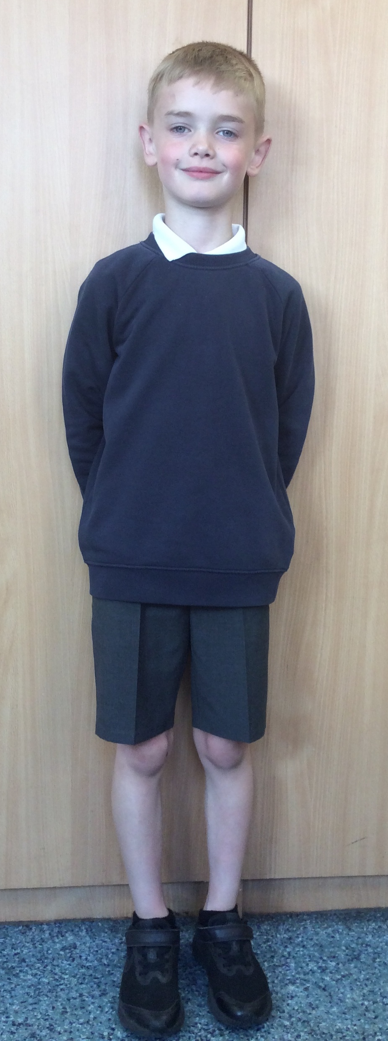
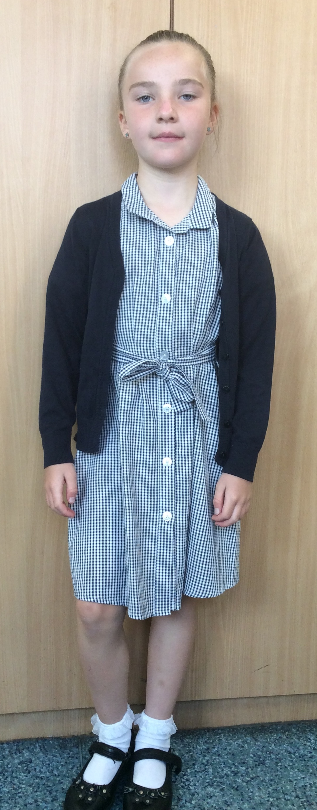
Uniform
Navy school jumper (with or without logo)
Navy school cardigan (with or without logo)
White polo shirt or shirt
Grey school trousers/skirt
Grey school dress
Blue checked school summer dress
Grey school shorts
Black shoes or trainers that children can fasten independently e.g. Velcro
Long hair must be tied up / no extreme hair styles
PE Kit
  Coloured t-shirt (Linked to teams used for PE etc)
  Black or grey PE shorts
    or
  Black or grey jogging bottoms or leggings
  Navy hooded top with logo

Slide 16
Communication
School communicates through email, text messages and sometimes paper letters.
Each Friday, a weekly newsletter comes home with details of all that is going on in school.
Class teachers will also email to share specific information and updates.
School can list 2 numbers as priority one contacts so that both parents receive any general text messages sent.
Please add the following emails to your contacts so that emails come straight to your inbox:
  manston.primary@manston.leeds.sch.uk
  no-reply@mail.arbor-education.com

Slide 17
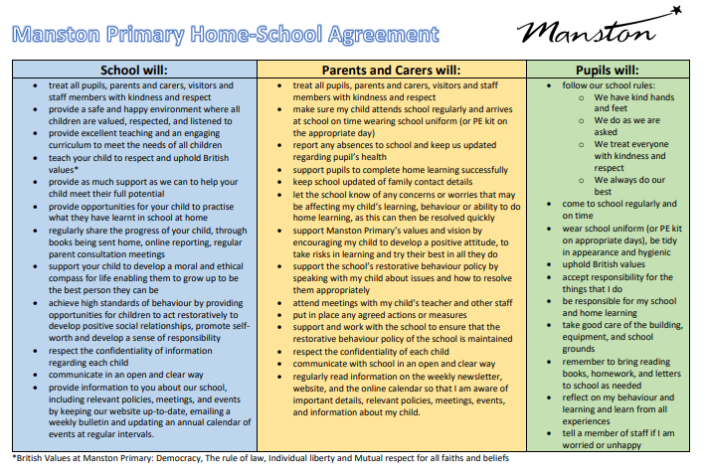
Home School Agreement
An updated copy of this, including an online safety pupil user agreement has come home recently.
Please review this at home with your child.
This agreement applies to all pupils, parents and staff at Manston Primary

Slide 18
Equipment
Each day children will need to bring:
A named water bottle
Named coats, hats, gloves suitable to the weather
Homework
Reading book
Pupils do not need:
Pencil cases
Toys or games
School staff will not spend time looking for items that are not named.

Slide 19
Attendance.
Our pupils have excellent attendance, and this is something we want to keep improving.
If your child is absent, please ring, email or speak with a member of staff in the office to let them know the details of the absence.
Please be reminded that school cannot authorise holidays in term time and any applications for exceptional leave must be made by filling in a form from the office.
School starts at 08:50 am each day and finishes at 3:15pm
Further details including our full policy can be found on our school website.

Slide 20
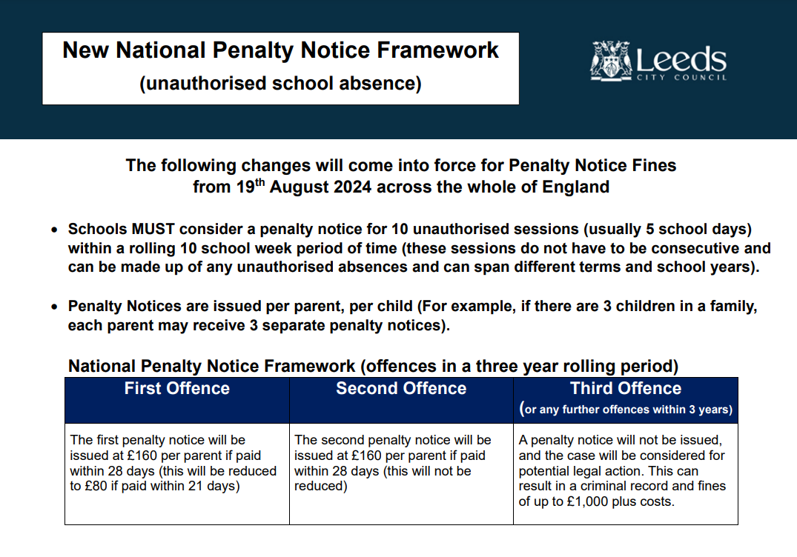

Slide 21
Frequently Asked Questions
What is the MTC?​
The MTC is an on-screen check (test) consisting of 25 times tables questions. Your child will answer 3 practice questions before moving on to the official check and will then have 6 seconds to answer each question. On average, the check should take no longer than 5 minutes to complete.​
https://www.gov.uk/government/collections/multiplication-tables-check ​
The purpose of the check is to determine whether pupils can fluently recall their times tables up to 12, which is essential for future success in mathematics. The test is compulsory for all Y4 children in England. ​It takes place in June.
Swimming: Every Wednesday unless told otherwise.
It is important that pupils attend swimming weekly. Swimming will be on a Wednesday and children need to bring a coat as well as their usual swimming gear as we walk no matter the weather.
Homework:
Homework is part of our school policy and is part of the home school agreement previously mentioned. Getting your child into a routine of doing homework will not only recap previous learning but will also prepare them for when they progress up school and homework is increased.
Towards the spring a lot of our homework focus goes on to TTRS and learning our times tables.

Slide 22

Data Checking
Please check/update the details we hold for your child to ensure we have:
At least 2 emergency contacts
Current emails/ addresses
Up to date medical information
Any medication / information is up to date
You can do this by emailing the school office or updating details on the Arbor App.

Slide 23
Any Questions?
School Email: manston.primary@manston.leeds.sch.uk
Class teacher email: kerri.meah@manston.leeds.sch.uk
maisy.dutton@manston.leeds.sch.uk
Queries about swimming: karen.cartwright@manston.leeds.sch.uk
Do not hesitate to get in touch if you have any questions or need some support.

