Slide 1

Meet the teacher
September 2026

Slide 2

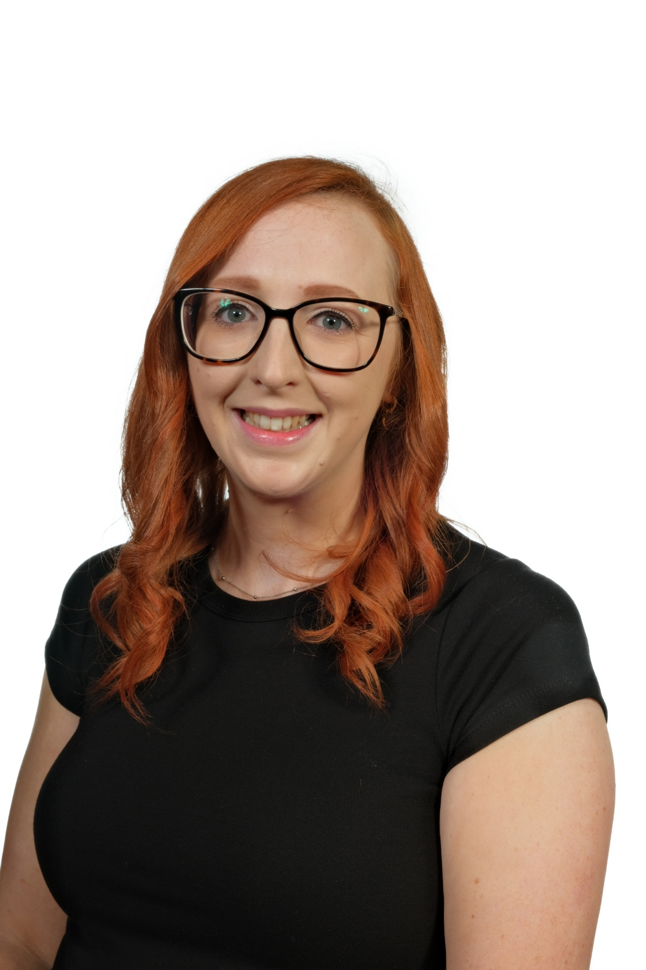
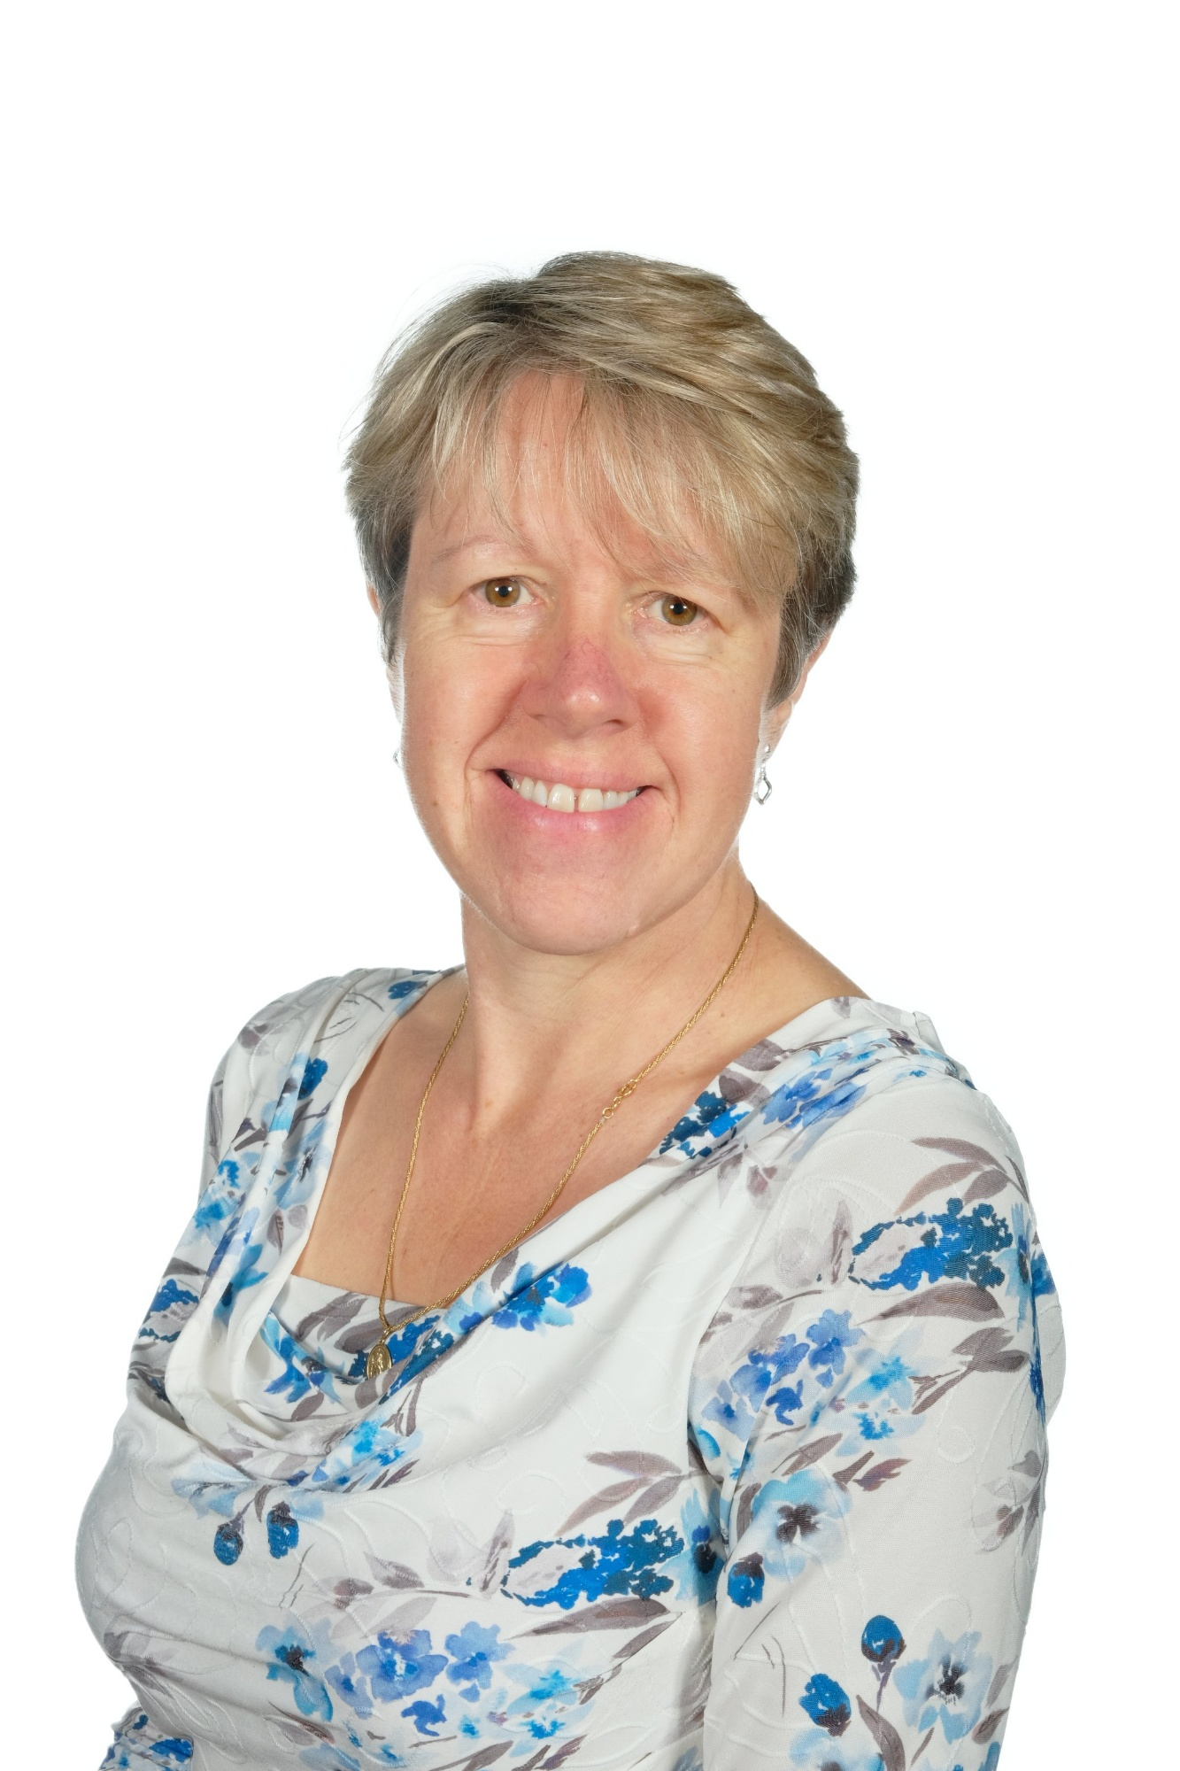
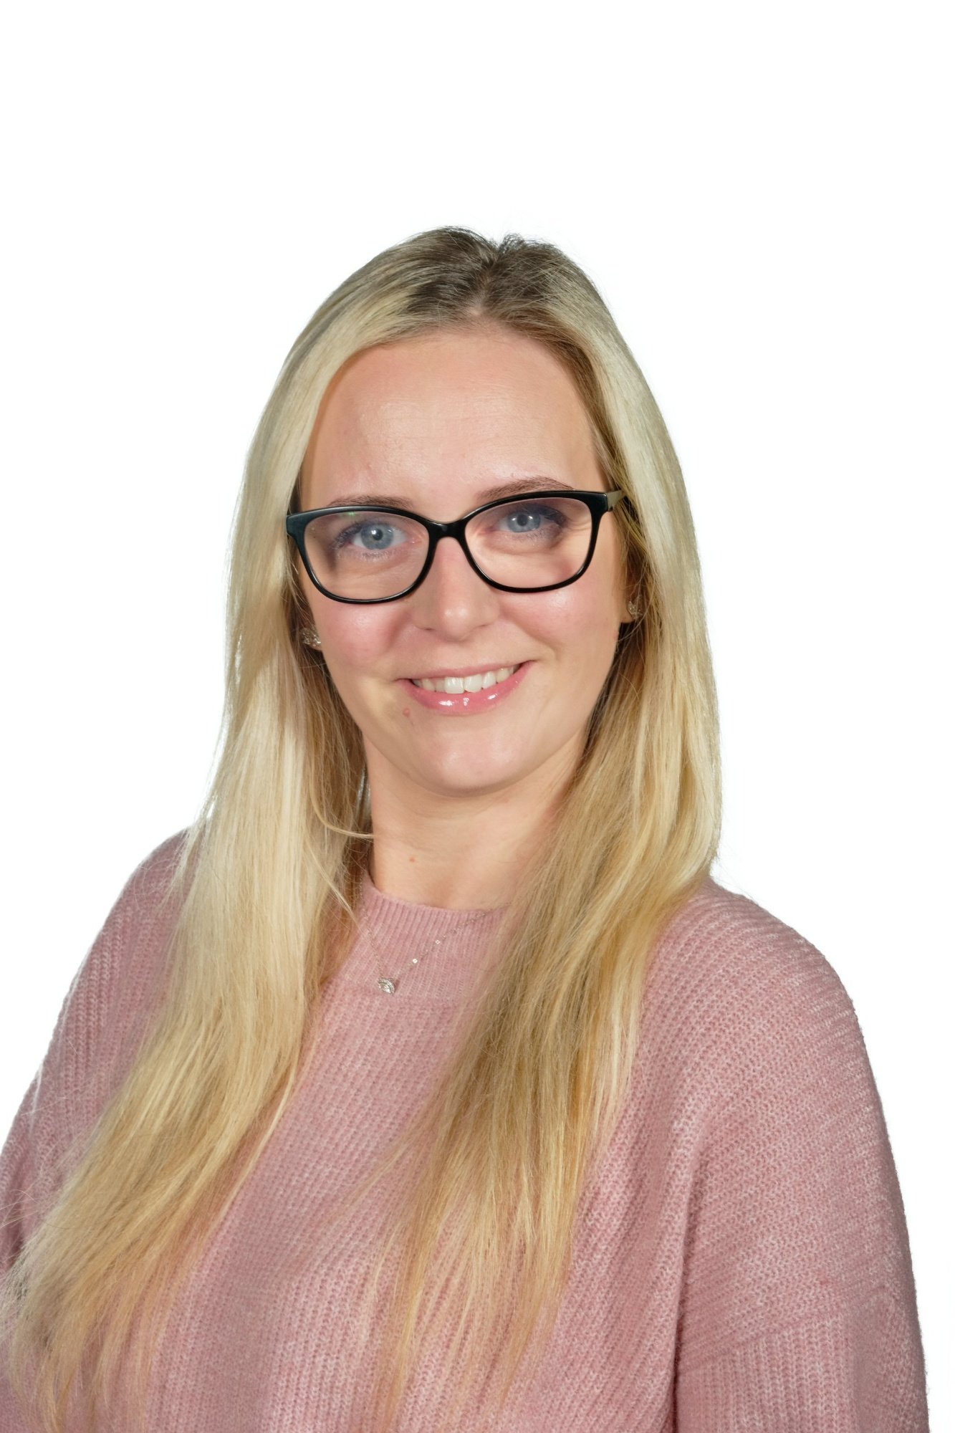
Staffing
Year 1 2026-2027
Mrs Alex Finn
Class Teacher / Assistant Headteacher
Monday - Thursday
Mrs Michelle Barrett
LSA: Monday, Wednesday, Thursday
Class Teacher: Friday
Mrs Rebecca Pearce
LSA: Tuesday, Wednesday, Friday

Slide 3
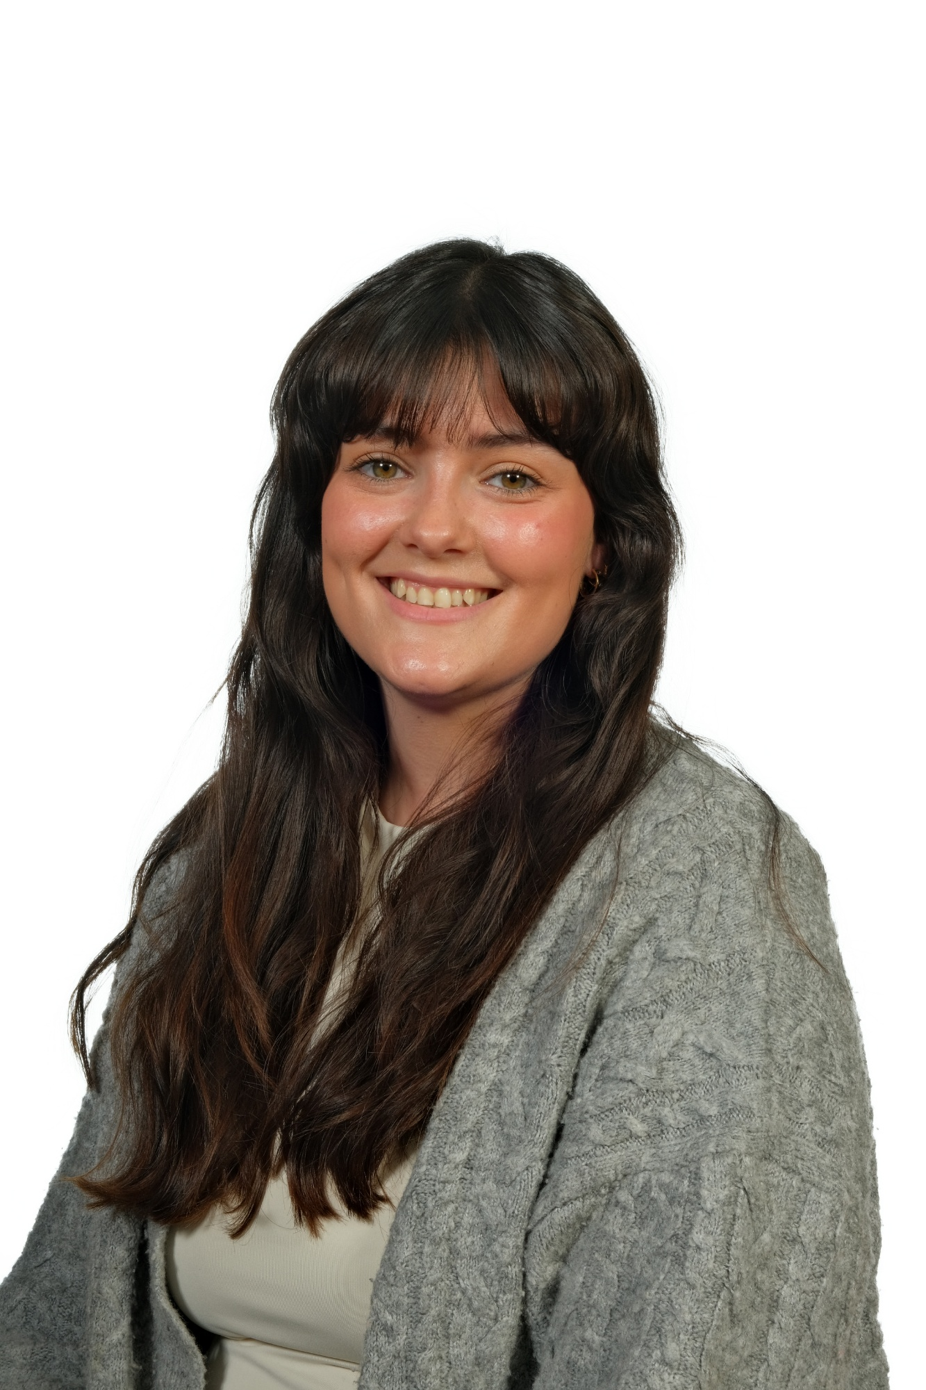
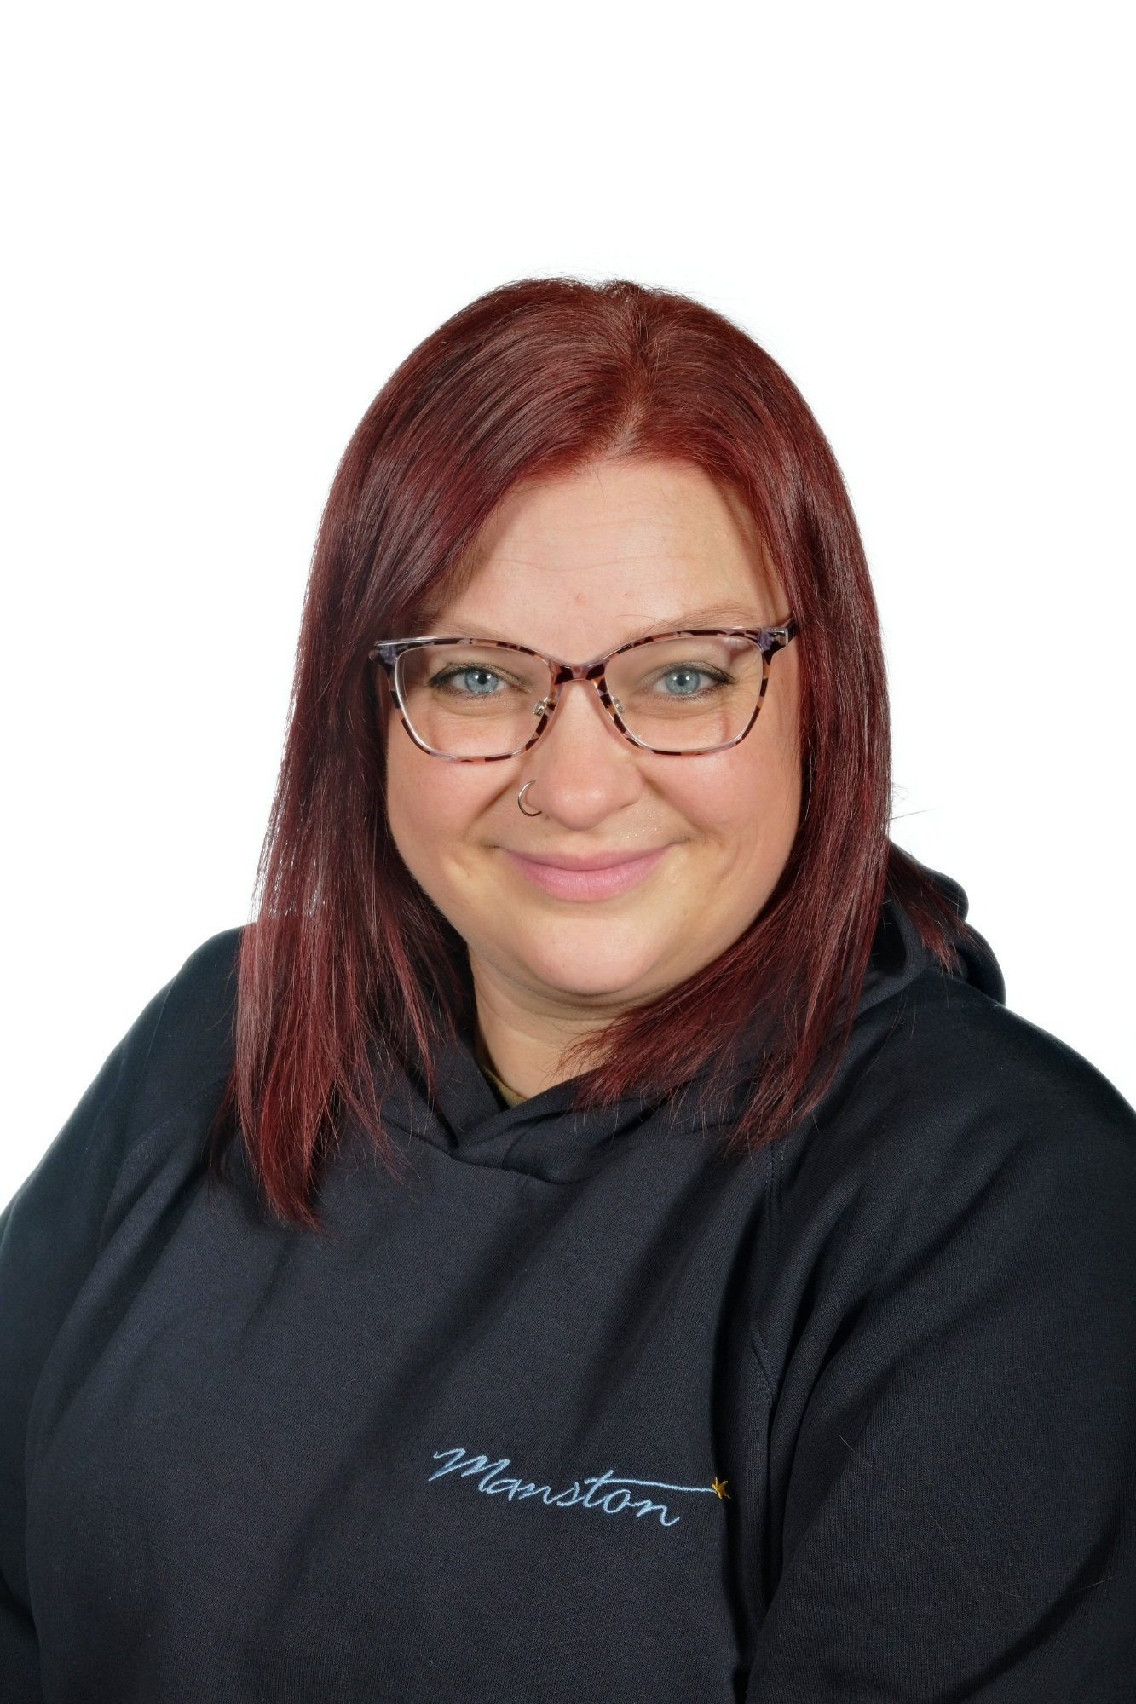
Mrs Dutton-Waugh
Class Teacher: Wednesday PM
Miss Kelly Turnbull
LSA: Monday-Friday
(Phonics support)

Slide 4
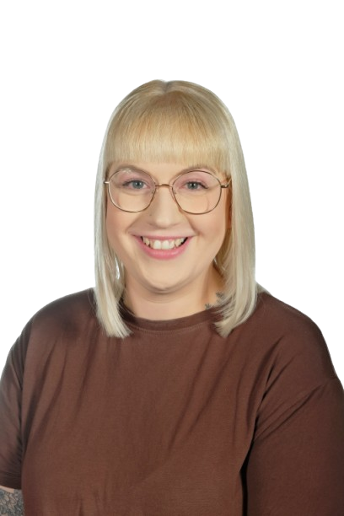
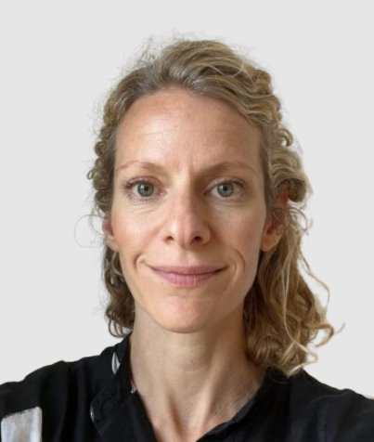
Inclusion Support Staff
2026-27
Elisabeth Porter
SENDCo
Kirsty Thorpe
Safeguarding and Welfare Officer

Slide 5
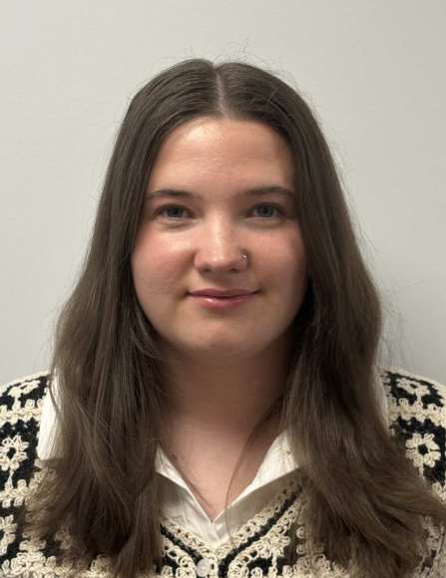
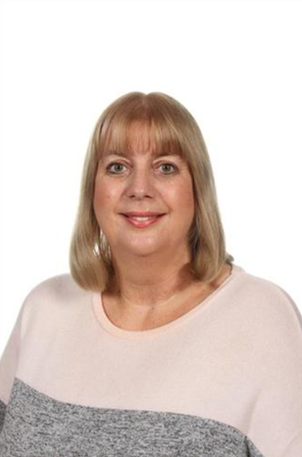
Inclusion Support Staff
2026-27
Miss Nevill- Behaviour and Inclusion Office
Mrs Joul – Learning Mentor

Slide 6

Child protection Staff

Slide 7
Daily timings
School starts at 08:50 am every day
Classroom doors will be open from 08:45 and pupils are invited to come straight inside
School ends at 03:15 pm every day
Break time for this class is at 10.20
Lunch time for this class is at 11.55

Slide 8
Timetable
*S&WS- Sounds and Words Session
Day | Lesson 1 | Break | Lesson 2 | Lesson 3 | Lunch | Lesson 4 | Lesson 5
Monday | Assembly/ Maths |  | English | Phonics |  | S&WS PE | Science
Tuesday | KS1 assembly/ Maths |  | English | Phonics |  | S&WS RE | Music
Wednesday | Singing assembly/ Maths |  | English | Phonics |  | S&WS PE | ICT
Thursday | Assembly Maths |  | English | Phonics |  | S&WS History / Geography | PSHE
Friday | Phonics |  | English | Phonics |  | Art/DT | Achievement Assembly

Slide 9
Weekly Events
Day | Event
Monday | PE (wear kit)
Tuesday
Wednesday | PE (wear kit) | Homework due
Thursday |  | Homework set
Friday |  | Achievement assembly
Please note that for PE earrings (studs only) need to be removed once the ears have been pierced for 6 months. If your child cannot do this unaided please send them in without earrings on PE days. Pupils with newly pierced ears will be required to tape up their ears during PE lessons for safety reasons.

Slide 10

Topics this term.
Phonics: This is taught every day. We continue to use the Floppy’s Phonics Scheme. An email will be sent out weekly to inform you of sounds taught. Your child will need to complete the pages in their Floppy’s workbook.
English:
This is taught each day. We start each session with handwriting. We practice letter formation / writing words and captions.
The Proudest Blue: Read and discuss, sequence and caption pictures from the story.
In Every House, on Every Street: Acrostic poem.
Traction Man: Letter of complain – first person.
Toys and Games: Old toy advert.
High expectations of handwriting, capital letters, finger spaces and full stops. Chances for children to edit and improve their work.
Maths: This is taught each day. We start the day with a 10 minute mastering number session (NCETM)
We use Oak Academy / NCETM schemes to teach Maths. This term we will be focusing on:
Previous Reception experiences and counting within 100
Comparison of quantaties and part-whole relationships
Numbers 0-5
Recognise, compose, decompose and manipulate 2D and 3D shapes

Slide 11
Topics this term
Science: Seasonal Changes / Everyday Materials
Geography: Fairtrade / The World and My School
History: Black History
RE: Why are festivals important in a community? How do Hindu stories help believers in their lives?
PSHE: My Healthy Self / Connecting With Others
Art: Make Your mark
DT: Mechanisms
Computing: Computing systems and Networks: mouse control
Music: following Charanga on-line music resource planning
PE: Fundamentals and Team Building

Slide 12
Homework
1 hour per week which could include
Phonics (weekly email)
Reading / spelling
Maths
English
Topics work
Reading at home 4 or 5 times a week for 10/15 minutes
Numbots / Oxford Owl access

Slide 13

Possible trips and events
Hopefully, we will be able to go on trips and take part in lots of exciting activities this year. These could include:
Local area walk
Tropical world / mini beast experience
Library
Local park
Circus activities – in school?

Slide 14

School Uniform
School uniform is supplied by Uniwears https://www.uniwears.co.uk/
0113 235 1256
info@uniwears.co.uk
More details can be found via the below link:
Uniform Webpage

Slide 15
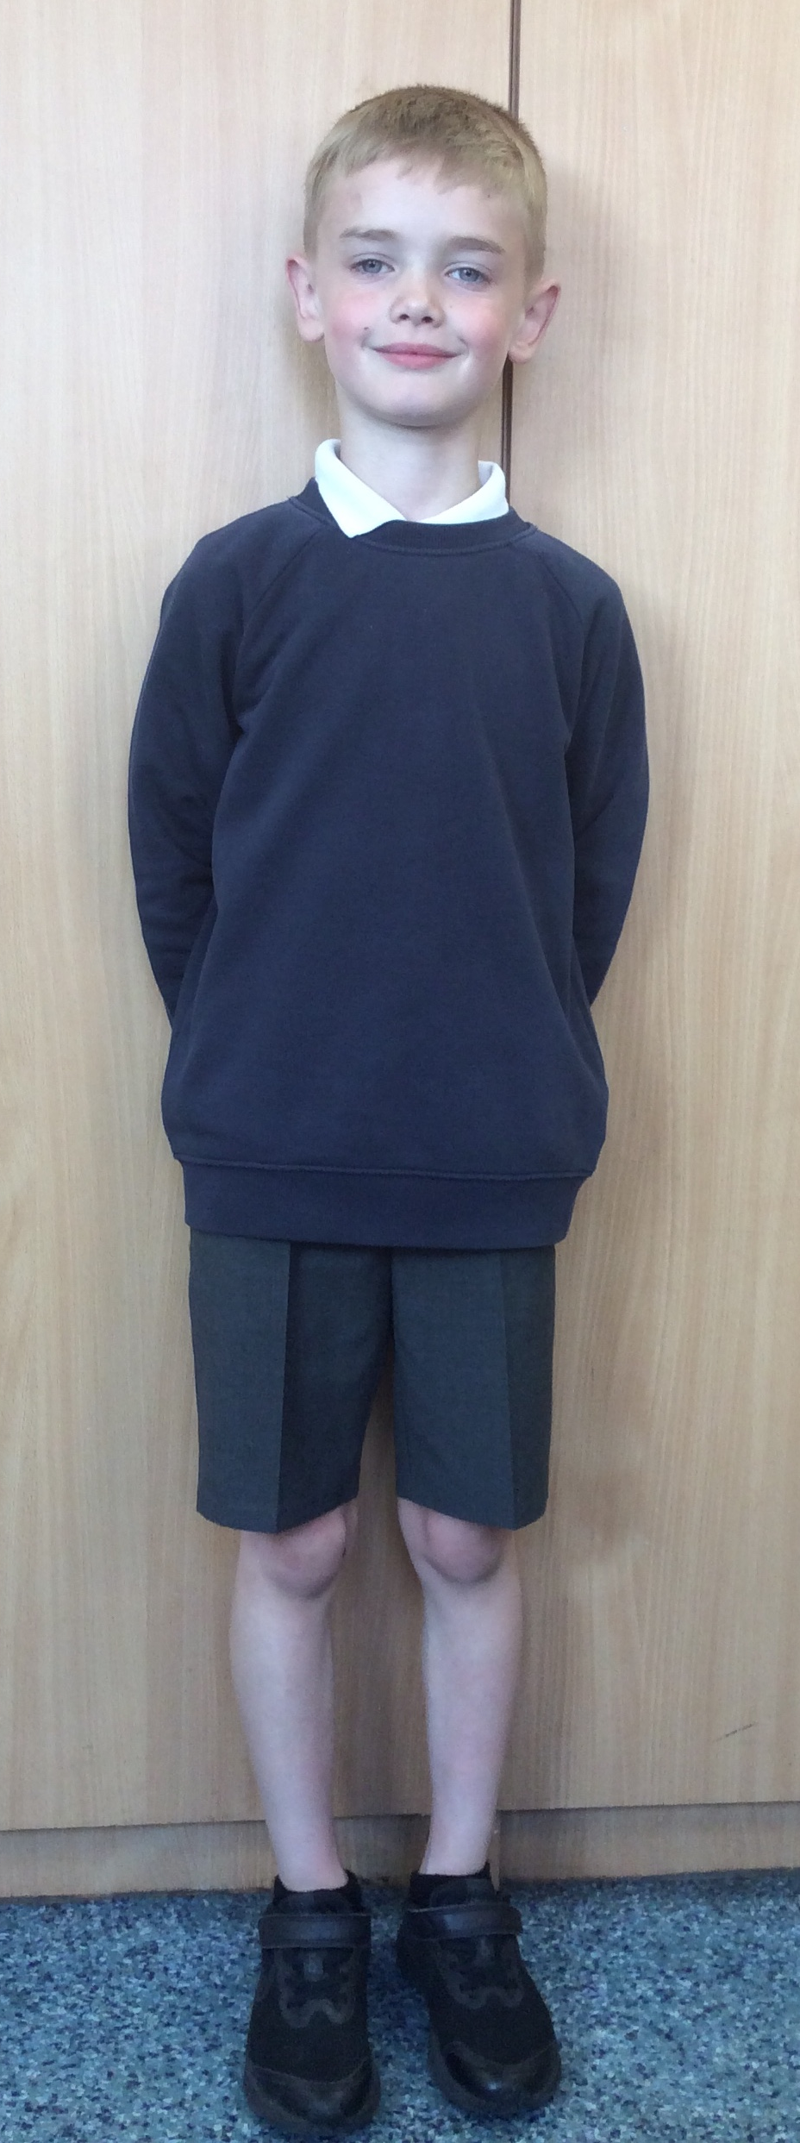
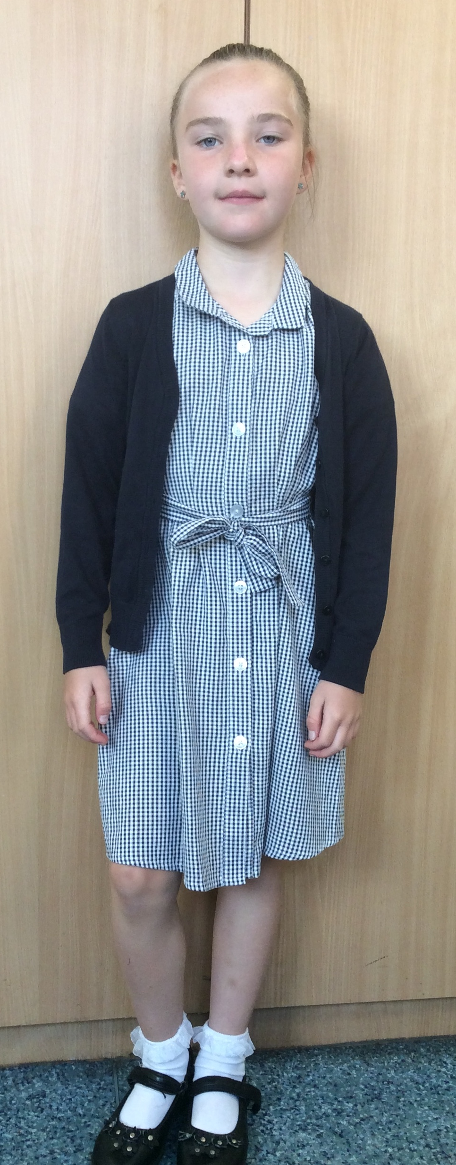
Uniform
Navy school jumper (with or without logo)
Navy school cardigan (with or without logo)
White polo shirt or shirt
Grey school trousers/skirt
Grey school dress
Blue checked school summer dress
Grey school shorts
Black shoes or trainers that children can fasten independently e.g. Velcro
Long hair must be tied up / no extreme hair styles
PE Kit
  Coloured t-shirt (Linked to teams used for PE etc – will be confirmed in an email in July 2024 and on home visits)
  Black or grey PE shorts
    or
  Black or grey jogging bottoms or leggings
  Navy hooded top with logo

Slide 16
Communication
School communicates through email, text messages and sometimes paper letters.
Each Friday, a weekly newsletter comes home with details of all that is going on in school.
Class teachers will also email to share specific information and updates.
School can list 2 numbers as priority one contacts so that both parents receive any general text messages sent.
Please add the following emails to your contacts so that emails come straight to your inbox:
  manston.primary@manston.leeds.sch.uk
  no-reply@mail.arbor-education.com

Slide 17

Home School Agreement
An updated copy of this, including an online safety pupil user agreement has come home recently.
Please review this at home with your child.
This agreement applies to all pupils, parents and staff at Manston Primary

Slide 18
Equipment
Each day children will need to bring:
A named water bottle
Named coats, hats, gloves suitable to the weather
Homework (Wednesday)
Reading book
Pupils do not need:
Pencil cases
Toys or games
School staff will not spend time looking for items that are not named.

Slide 19
Attendance.
Our pupils have excellent attendance, and this is something we want to keep improving.
If your child is absent, please ring, email or speak with a member of staff in the office to let them know the details of the absence.
Please be reminded that school cannot authorise holidays in term time and any applications for exceptional leave must be made by filling in a form from the office.
School starts at 08:50 am each day and finishes at 3:15pm
Further details including our full policy can be found on our school website.

Slide 20
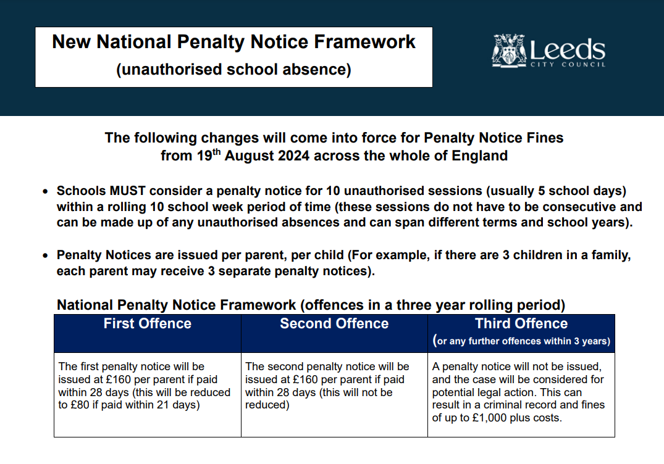

Slide 21
Frequently Asked Questions
What is the Phonics Screening Check and how can I support my child?​
​
How is learning in Year 1 different from Reception?​
What does Maths learning look like in Year 1?​
How can I support my child with their learning at home?​
We would like to invite you into the classroom throughout the year!
Phonics stay and plays
Reading sessions
What would you like to get out of a visit?

Slide 22

Data Checking
Please check/update the details we hold for your child to ensure we have:
At least 2 emergency contacts
Current emails/ addresses
Up to date medical information
Any medication / information is up to date
You can do this by emailing the school office or updating details on the Arbor App.

Slide 23
Any Questions?
School Email: manston.primary@manston.leeds.sch.uk
Class teacher email: alex.finn@manston.leeds.sch.uk
Do not hesitate to get in touch if you have any questions or need some support.

