Slide 1

Meet the teacher
September 2026

Slide 2

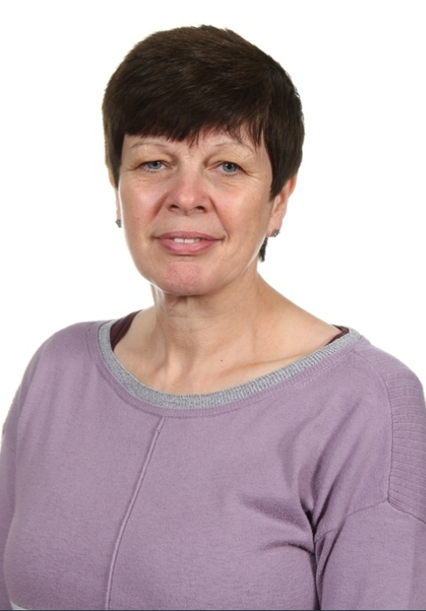
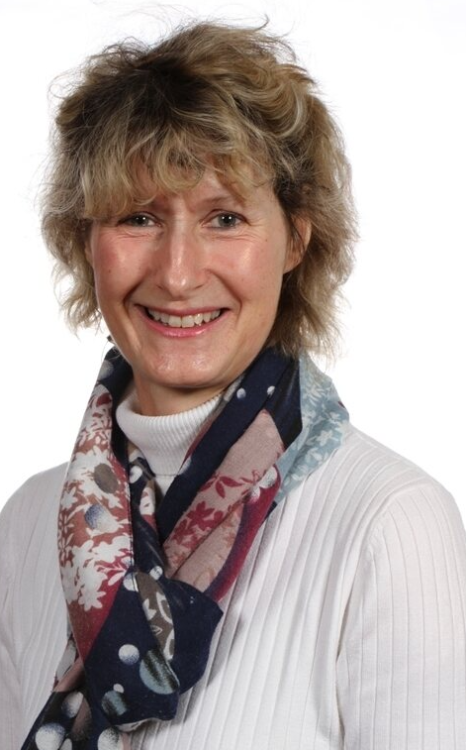
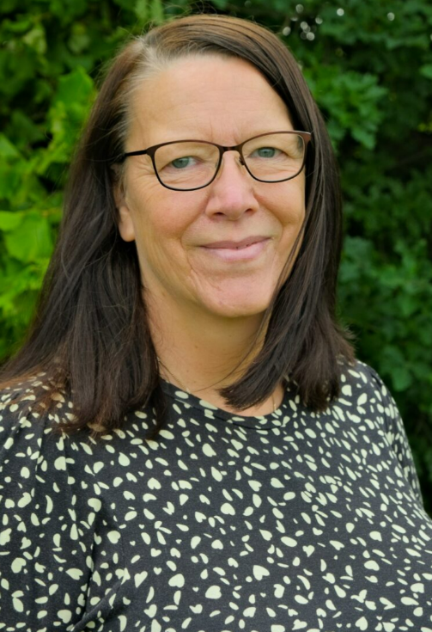
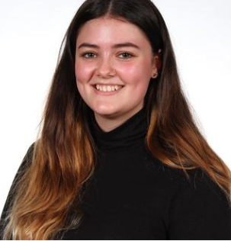
Staffing
Year 2 – 2023-24
Mrs Lamb
LSA Monday, Tuesday, Thursday & Friday
Mrs Jennings
Teacher
Mrs Dutton-Waugh
Teacher on Monday PM
Miss Oddy
LSA Wednesday

Slide 3
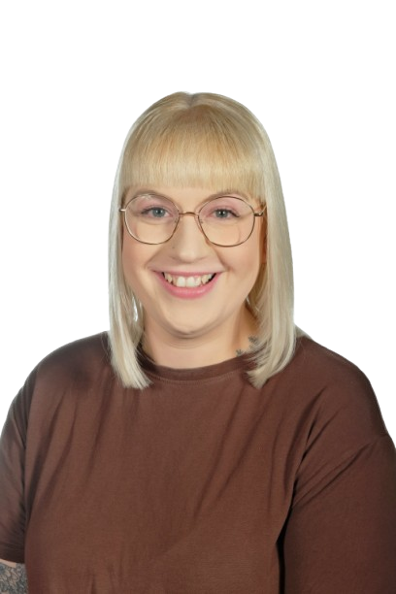
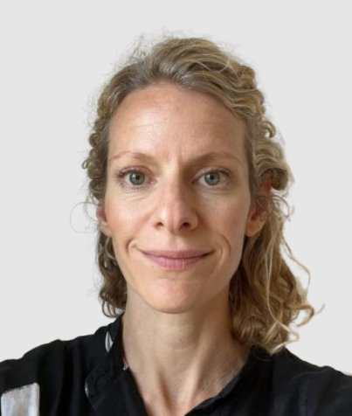
Inclusion Staff
2026-27
Elisabeth Porter
SENDCo
Kirsty Thorpe
Safeguarding and Welfare Officer

Slide 4
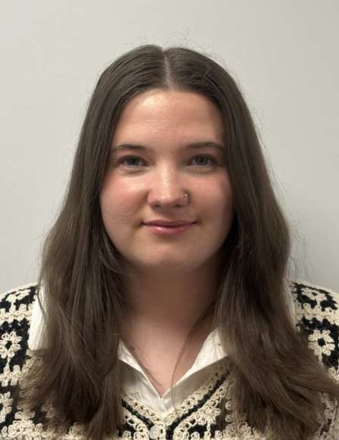
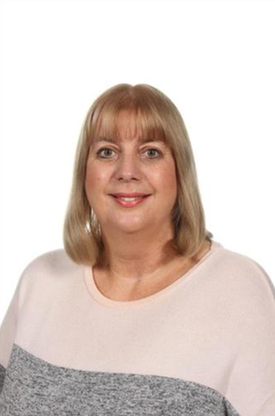
Inclusion Staff
2026-27
Miss Nevill-
Behaviour and Inclusion Officer
Mrs Joul – Learning Mentor

Slide 5

Child Protection Staff

Slide 6
Daily timings
School starts at 8:50 am every day
Classroom doors will be open from 08:45 and pupils are invited to come straight inside
School ends at 3:15 pm every day
Break times for this class are at 10:20am
and between 2/2:30pm
Lunch time for this class is at 12:05pm

Slide 7
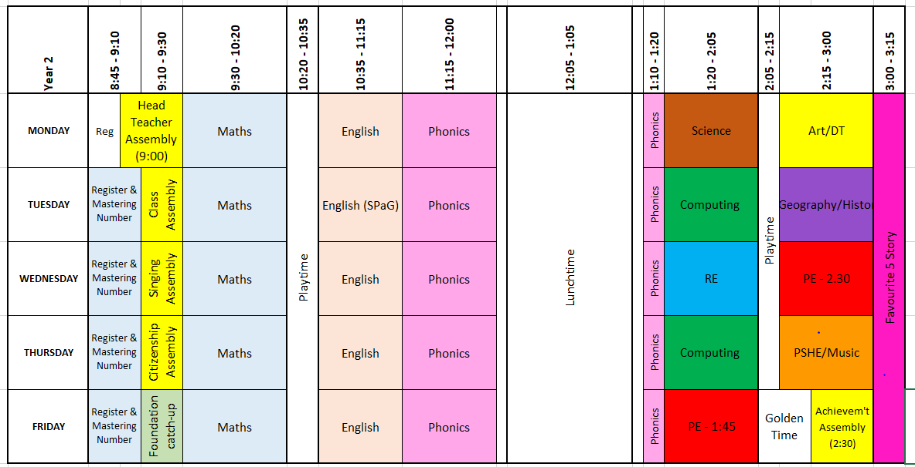
Timetable

Slide 8
Weekly Events
Day | Event
Monday
Tuesday
Wednesday | PE (wear kit)
Thursday |  | Homework due
Friday | PE (wear kit) | Homework set Achievement assembly
Please note that for PE earrings (studs only) need to be removed once the ears have been pierced for 6 months. If your child cannot do this unaided please send them in without earrings on PE days. Pupils with newly pierced ears will be required to tape up their ears during PE lessons for safety reasons.

Slide 9

Topics this term.
Phonics:
This is taught daily for the Autumn term, focusing on reading one day and writing the next. There will be ongoing phonic interventions for children who did not pass the PSC in year 1 and daily reading. Please try to read with your child for 5-10 minutes each day as this will support what we are doing in class and promote a love of reading.
English:
This is taught each day. Over the year there will be a continued focus on grammar, writing skills, spelling, and reading. We will learn a new text each half term that we will imitate, innovate and invent our own stories, letters, diaries, and reports. The text types that we are focusing on this term are; retelling a story, non-fiction (letter writing)
High expectations of handwriting, capital letters, finger spaces and full stops. Chances for children to edit and improve their work using their purple pen. ​

Slide 10
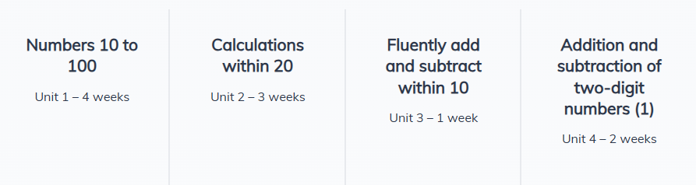
Topics this term.
Maths:
This is taught each day. We start the day with a 10 minute mastering number session (NCETM)​
We use Oak Academy / NCETM schemes to teach Maths.
This half-term we begin with number; specifically numbers to 100, place value and addition/subtraction.
Activities in maths lessons will require the children to think, question and apply skills they have. We aim to make them all confident and logical in their approach to work.
​

Slide 11
Topics this term.
Science: Habitats
Geography: Oceans and Continents, Antarctica, Fairtrade
History: Ernest Shackleton, Black History (Black History month in October)
RE: How can we make good choices?
PSHE: Mental health, wellbeing and friendships
Art: Colour mixing, primary and secondary colours, painting
Computing: Online Safety, learning about computer skills, and numbots practice
Music: Charanga online music resource
PE: Fundamentals and teambuilding
(PE will be on Wednesday pm and Friday pm – wear PE kit to school)

Slide 12
Homework
Years 2
1 hour per week which will include Reading, Spelling/Phonics, other English and Maths work or topic work
Reading at home 4 or 5 times a week for 5/10/15 minutes
You should have all been provided with Numbots, Oxford Owl and Bug Club log ins. If you have not got this, or need it again, please let me know and I can sort asap!
The websites below will also give you further helpful information: ​
http://www.nnparenttoolkit.org.uk/information-for-parents/ (Maths) ​
http://www.theschoolrun.com/ (Maths, English and other primary subjects) ​

Slide 13
Homework
Homework will consist mainly of spelling practice, reading, an English task or a Maths task.
Additional homework may be set to do some extra Numbots practise.
Homework may increase each term as children get more used to the routine of completing it.
Children should read for pleasure for at least 5-10 minutes each night.
You can support your child by reading with them, showing an interest in their work and encouraging them to complete any set tasks punctually.
We expect all children to have a go at homework that is set. We will discuss tasks before they go home but if your child is uncertain, please feel free to explain it or re-direct them back to us for some help.
Completed homework that is handed in on time earns children 5 team points.

Slide 14

Possible trips and events
Hopefully, we will be able to go on trips and take part in lots of exciting activities this year.
These could include:
Local area walk
Skelton Grange
Ponderosa Zoo
KS1 Reward for holiday homework – TBC.

Slide 15

School Uniform
School uniform is supplied by Uniwears
info@uniwears.co.uk
More details can be found via the below link:
Uniform Webpage

Slide 16
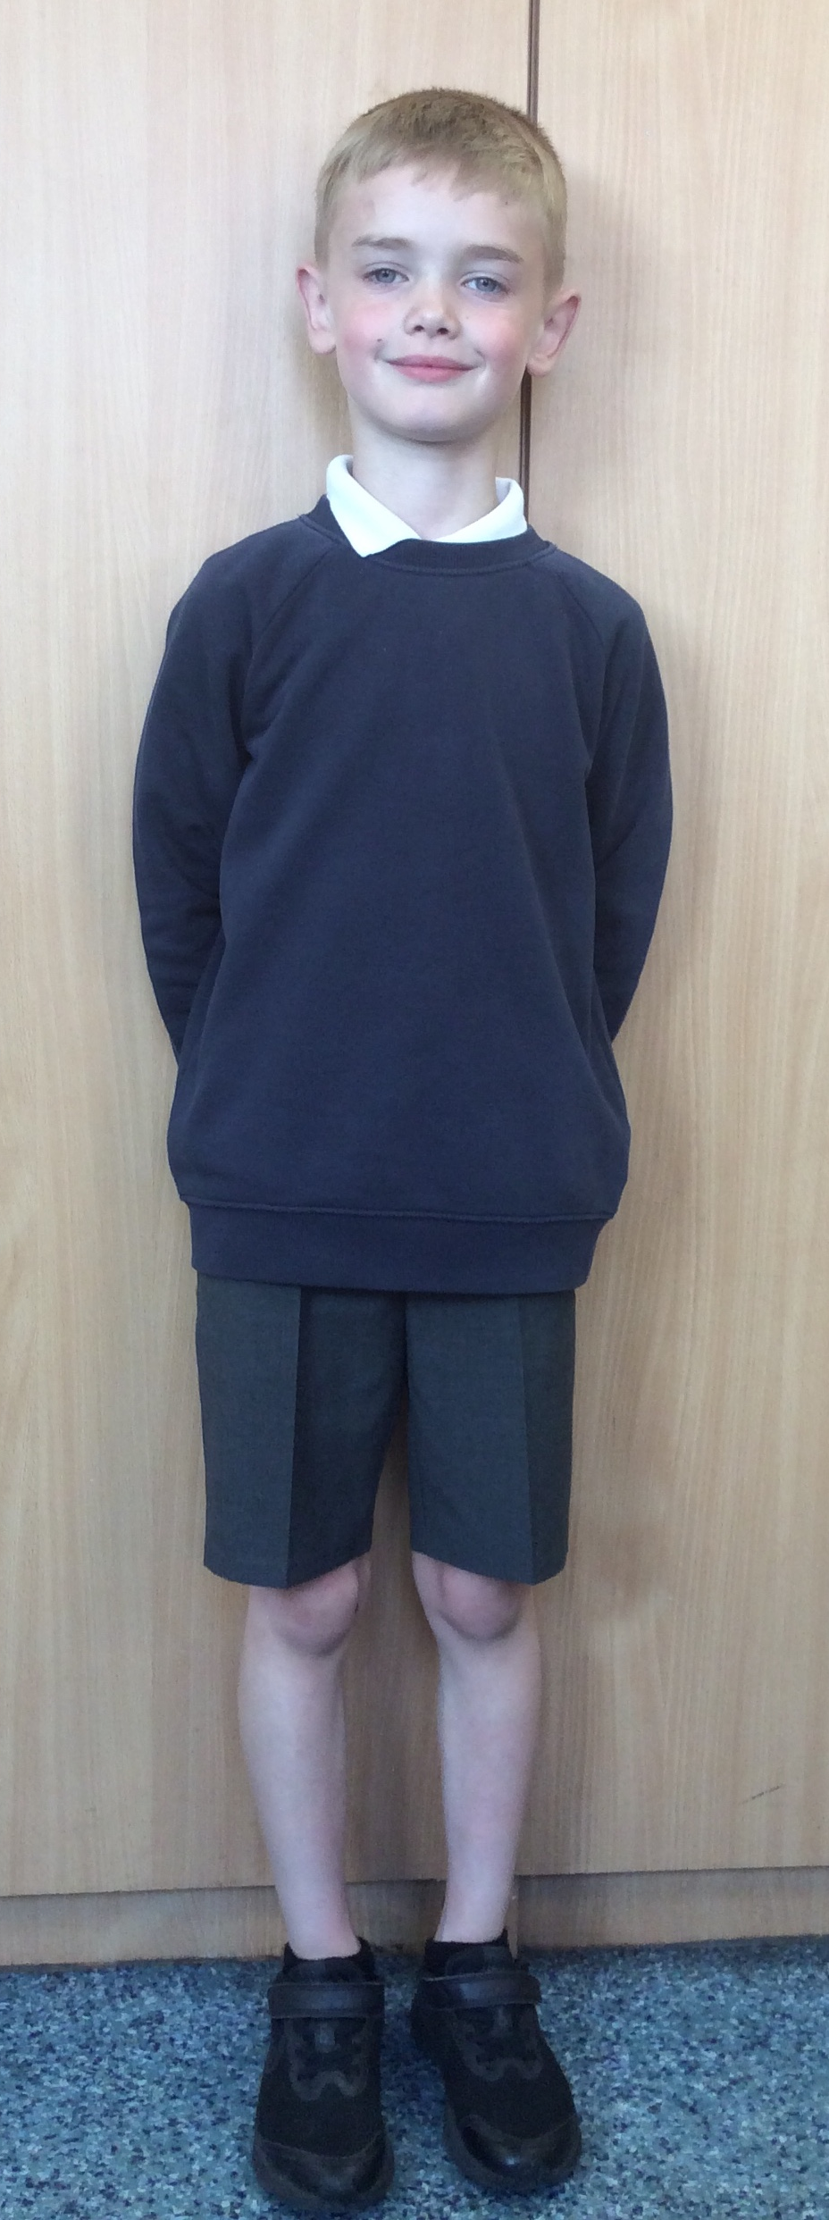
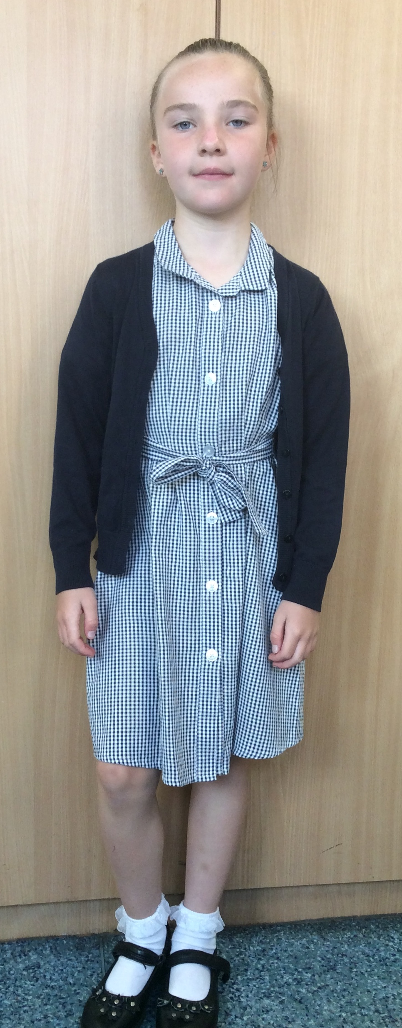
Uniform
Navy school jumper (with or without logo)
Navy school cardigan (with or without logo)
White polo shirt or shirt
Grey school trousers/skirt
Grey school dress
Blue checked school summer dress
Grey school shorts
Black shoes or trainers that children can fasten independently e.g. Velcro
Long hair must be tied up / no extreme hair styles
PE Kit
  Coloured t-shirt (Linked to teams used for PE etc – will be confirmed in an email in July 2024 and on home visits)
  Black or grey PE shorts
    or
  Black or grey jogging bottoms or leggings
  Navy hooded top with logo

Slide 17
Communication
School communicates through email, text messages and sometimes paper letters.
Each Friday, a weekly newsletter comes home, via email, with details of all that is going on in school.
Class teachers will also email to share specific information and updates.
School can list 2 numbers as priority one contacts so that both parents receive any general text messages sent.
Please add the following emails to your contacts so that emails come straight to your inbox:
  manston.primary@manston.leeds.sch.uk
  no-reply@mail.arbor-education.com

Slide 18

Home School Agreement
An updated copy of this, including an online safety pupil user agreement has come home recently.​
Please review this at home with your child.​
This agreement applies to all pupils, parents and staff at Manston Primary

Slide 19
Equipment
Each day children will need to bring:
A named water bottle
Named coats, hats, gloves suitable to the weather
Homework (due by Thursdays)
Reading book
Pupils do not need:
Pencil cases
Toys or games
School staff will not spend time looking for items that are not named.

Slide 20
Attendance.
Our pupils have excellent attendance, and this is something we want to keep improving.
If your child is absent, please ring, email or speak with a member of staff in the office to let them know the details of the absence.
Please be reminded that school cannot authorise holidays in term time and any applications for exceptional leave must be made by filling in a form from the office. No work will be provided if you take children out during term time.
School starts at 8:50 am each day and finishes at 3:15pm
Further details including our full policy can be found on our school website.
Please note that new legislation about term-time holidays came into force in August 2024.

Slide 21
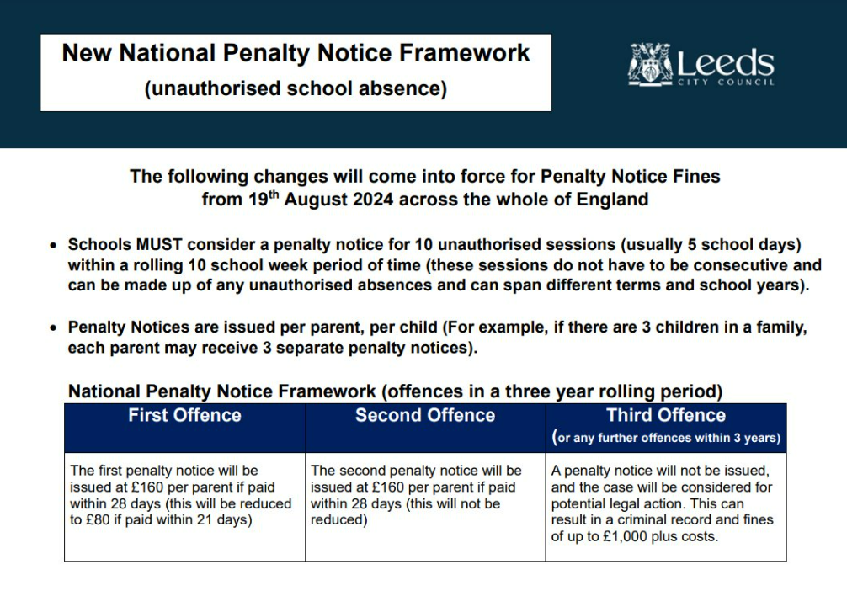

Slide 22
Frequently Asked Questions
When are SATs?
SATs for Year 2 will no longer take place but children will still be formally assessed to track their progress. This will take place in July.
Please try to avoid booking a holiday during term time as it is important that your child does not fall behind on their learning.
How can I help my child prepare for assessments?
Encourage and support them to complete homework.
Encourage them to take responsibility for themselves and their belongings: PE kit, homework, letters etc
Support them in learning 2, 5, and 10 times tables and number bonds to 10, 20 and 100.
Be interested in what they are reading and talk with them about the books.
When do you do relationship and sex education?
This is done in the spring term, starting in January. A letter will be sent to parents first with details of what will be taught. We feel it is really important that children are given clear teaching of this topic rather than hearing it inaccurately from their peers.

Slide 23

Data Checking
Please check/update the details we hold for your child to ensure we have:
At least 2 emergency contacts
Current emails/ addresses
Up to date medical information
Any medication / information is up to date
You can do this by emailing the school office or updating details on the Arbor App.

Slide 24
Any Questions?
School Email: manston.primary@manston.leeds.sch.uk
Class teacher email: glenda.jennings@manston.leeds.sch.uk
Do not hesitate to get in touch if you have any questions or need some support.

